Slide 1
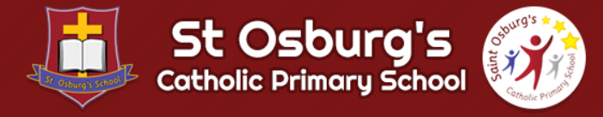
Welcome to Nursery
2022

Slide 2
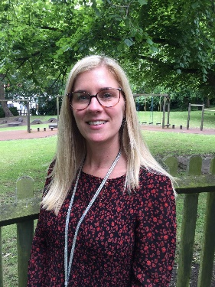
Hello Parents,
I would like to warmly welcome you and your child to their Nursery year with us at St Osburg’s Nursery.
Myself and all the Nursery team are really looking forward to working in partnership with you to make your child’s time at our Nursery an exciting and fun-filled journey of discovery and learning. Thank you for choosing our Nursery and giving us this opportunity.
We want to make sure that your child feels happy, safe and secure to ensure that they develop positive relationships and memorable experiences this year.
Please do not hesitate to contact me with any worries, queries or concerns you may have and I will always be happy to discuss these with you. You can speak to me first thing in the morning as you drop you child off to Nursery or alternatively contact the school office on
024 76227165.
Mrs Gee
Nursery Teacher

Slide 3
The Early Years Foundation Stage
This power point has been prepared for you to share some key information about your child’s Nursery experience.
Your child’s curriculum has seven areas of learning.
Prime Areas – universal core aspects of early child development
Communication and Language
Personal, Social, Emotional Development
Physical Development
Specific Areas - essential skills and knowledge that are underpinned by the prime areas
Literacy
Mathematical Development
Understanding the World
Expressive Arts and Design
In Nursery, there is a strong focus on the Prime areas of Learning as these lay the foundation for children’s success in all other areas of learning and life. As children develop and move into Reception, there is a greater focus on the Specific areas of learning to ensure children are ready for school in Year 1.

Slide 4



Supporting learning through sharing stories
Key Texts
In Nursery we share key texts across the year to support our themes and topics. These are displayed on the window by the classroom door. It would be great if you could borrow these from a library or treat your children to one of them for their Birthday or Christmas.
Library Books
Each week we send home a school library book for you to enjoy at home (this will begin in October). You can keep these for up to a week to enjoy with your child. Books are changed by staff when they are placed into the yellow book box.
Bedtime Bag
During the year, the children will all get a chance to have the class Bedtime Bag with a story, cuddly toy, hot chocolate sachet and a biscuit to enjoy with their family at bedtime. Please post the cute pictures onto Tapestry!

Slide 5
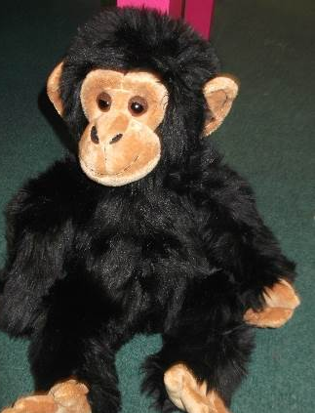
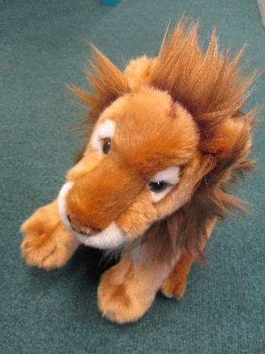
Supporting learning through talk activities
Teddy Visits
We have 2 special friends in Nursery who like to visit the children at home. They are called Maddy Monkey and Lenny Lion. During the Each child will get the opportunity to take one of these home to have fun with. Please take photos and put them into the diaries so the children can tell us all about the fun they get up to during their stay with you when they return to Nursery. If you are going somewhere extra exciting or have a special celebration planned, please let us know and we will arrange for you to take one of them with you.

Slide 6
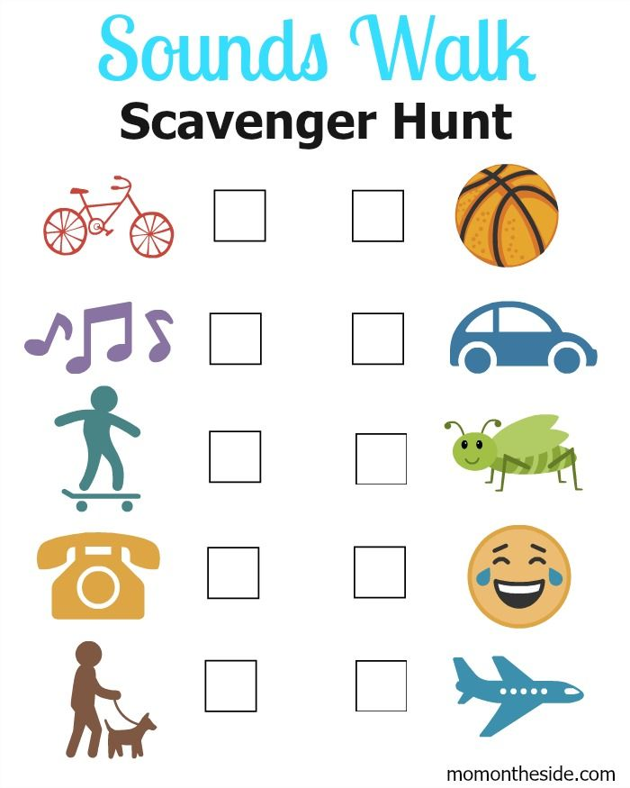
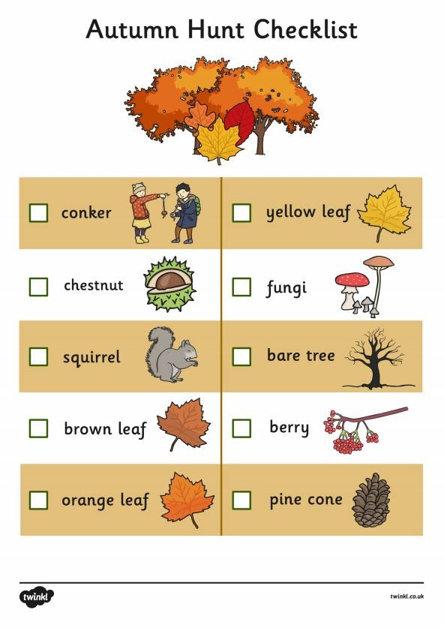
Home Learning
During the year there will be times when home learning resources and activities will be shared with you. These are to be enjoyed at home together and you can share your comments, photographs and ‘Wow’ moments by posting these on Tapestry.

Slide 7

Reminders
Activate your Tapestry account by following the email sent to you and create a password and pin.
Please read the newsletter every Friday for updates and school news.
Please check our school website and Nursery Class Page for news and updates.
Please follow us on Twitter @SaintOsburgs

