Slide 1

Wednesday 3rd March
LO: To know the story of the Temptation of Jesus.

Slide 2
What is temptation?
I would like you to think about the word ‘temptation’.
What does it mean?
Create a mind map containing words and phrases that are associated to this term.
temptation

Slide 3
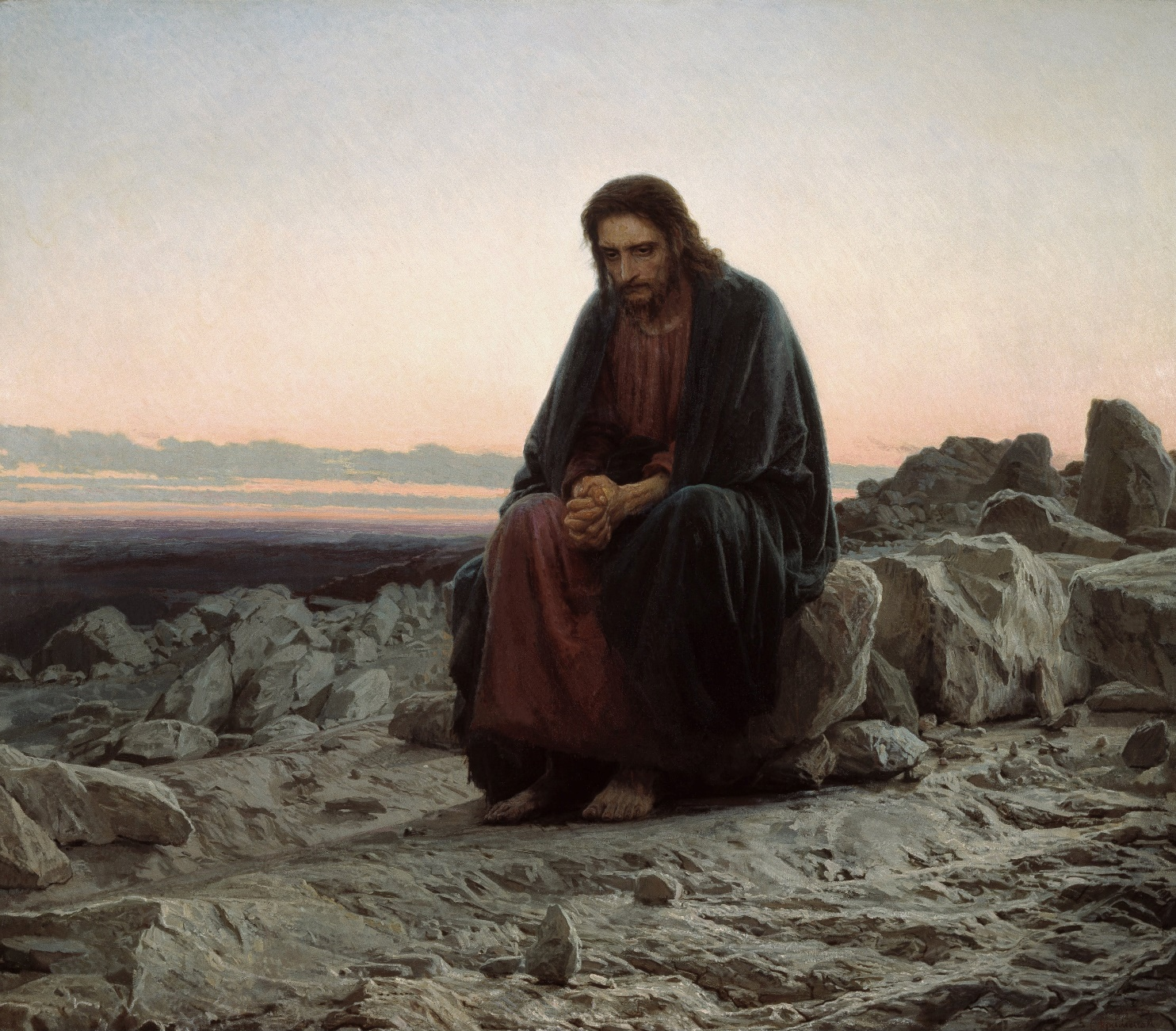
Today, we are focusing on Jesus’ time spent in the wilderness.
Let’s read the Bible verses and watch a short video about the temptation of Jesus.
Lent is often referred to as a desert experience. In the light of the temptation of Jesus, why do you think this is so?

Slide 4
Matthew 4:1-11
Jesus Is Tested in the Wilderness
4 Then Jesus was led by the Spirit into the wilderness to be tempted^{[a]} by the devil. ² After fasting forty days and forty nights, he was hungry. ³ The tempter came to him and said, “If you are the Son of God, tell these stones to become bread.”
⁴ Jesus answered, “It is written: ‘Man shall not live on bread alone, but on every word that comes from the mouth of God.’^{[b]}”
⁵ Then the devil took him to the holy city and had him stand on the highest point of the temple. ⁶ “If you are the Son of God,” he said, “throw yourself down. For it is written:
“‘He will command his angels concerning you,
and they will lift you up in their hands,
so that you will not strike your foot against a stone.’^{[c]}”
⁷ Jesus answered him, “It is also written: ‘Do not put the Lord your God to the test.’^{[d]}”
⁸ Again, the devil took him to a very high mountain and showed him all the kingdoms of the world and their splendor. ⁹ “All this I will give you,” he said, “if you will bow down and worship me.”
¹⁰ Jesus said to him, “Away from me, Satan! For it is written: ‘Worship the Lord your God, and serve him only.’^{[e]}”
¹¹ Then the devil left him, and angels came and attended him.

Slide 5
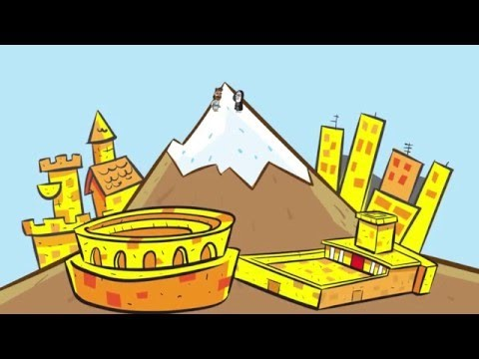

Slide 6
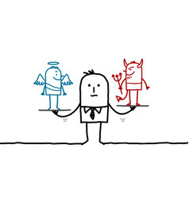
Now that you know the story well, I would like you to think about the following questions:
Do you think that it was difficult to say ‘no’ to the devil?
How can you tell the difference between doing something that is right or wrong?
What is it like when you are tempted to do something you shouldn’t?
How can we resist the things that are wrong?
You don’t have to write your answers down.

Slide 7
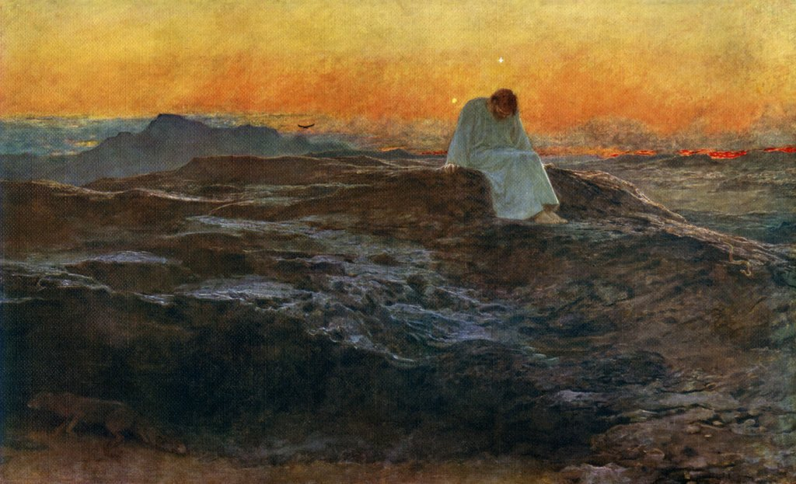
Imagine that you are Jesus.
Write a short diary entry about the temptations and how it affected you.

