Slide 2
Learning Objective
To understand the purpose of narrative writing in order to successfully plan and write one.
Success Criteria
To understand the purpose of narrative writing.
To understand that a narrative contains an orientation, series of events, complication, resolution, and coda (optional).
To understand the importance of complications in narratives.
To plan and write a narrative using the correct structure.

Slide 3

Purpose
The purpose of narratives
is to tell a story.
They can teach the reader a moral
or a lesson.
They can be both informative and entertaining.
Narratives can be written in many forms, for example: myths, fairy tales, fables, parables, science fictions, adventure, historical, romance,
mystery, horror, humorous and
fantasy stories.

Slide 4
Structure
The way a narrative is structured is very important. Here are several key points that can help guide us when writing a narrative.
We are going to look at using OSCRC to structure our narrative.
Structure | Purpose
Orientation | A short introduction about the main characters and settings. Who, what, when, where, why?
Series of Events | Well structured, and sequenced events which tell the reader a story, and reveal more about the information presented in the orientation.
Complication | This is embedded into the series of events. It is where a potential problem occurs and the whole narrative is based around this, and how it will be solved.
Resolution | The complication is resolved and the narrative ends.
Coda (optional) | Gives the audience some extra information in regards to how the character(s) were feeling, how they have changed, and what could be taken from this narrative.

Slide 5
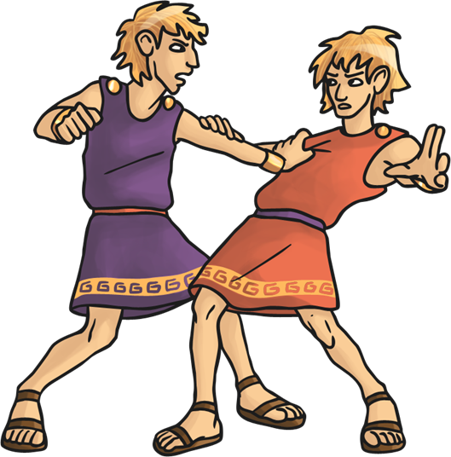
The Crisis
In almost every story you read, there will be a crisis or problem.
Think of five stories that you have read (or films you have seen) and identify what the problem was. Discuss these with your partner.
Can you identify any other common themes in terms of structure?
Pause for Thought
Why do you think stories need a crisis?
What would happen if everything just
went well?

Slide 6
Orientation
The main purpose of your orientation is to ‘hook’ the readers’ interest and make them want to read on.
There are many ways to do this, but you may try:
Action: Get straight to the point; begin your narrative in the heat of battle.
‘Charging at the old, abandoned door of the house, he used all his strength to force it open.’
Dialogue: Slightly less dramatic than full-blown action, but still gets into the story quickly.
‘“How on earth could that have possibly happened!” complained Andrew.’
Character: Immediately give the readers someone to connect with.
‘Her curls of golden hair fell across her face, catching the light from the glistening moon.’
Setting: Immediately give the readers somewhere to imagine.
‘The stale smell lingered in the air. The smell of rotting wood could be sensed from towns away. It had not been entered for years.’

Slide 7

Orientation
If your orientation raises questions, it will keep the reader interested.
Action: Get straight to the point; begin your narrative in the heat of battle.
‘Charging at the old, abandoned door of the house, he used all his strength to force it open.’
Dialogue: Slightly less dramatic than full-blown action,
but still gets into the story quickly.
“How on earth could that have possibly happened!”
complained Andrew.’
What’s behind the door? Is he running away from something? Does he want to get in or out?
What has happened? Who is Andrew?

Slide 8
Orientation
If your orientation raises questions, it will keep the reader interested.
Character: Immediately give the readers someone to connect with.
‘Her curls of golden hair fell across her face, catching the light from the glistening moon.’
Setting: Immediately give the readers somewhere to imagine.
‘The stale smell lingered in the air. The smell of rotting wood
could be sensed from towns away. It had not been
entered for years.’
Who is this girl? What is so great about her?
Where do you think this place is?
Why do you think it has not been entered?
Why do you think rotting wood can be smelt?

Slide 9
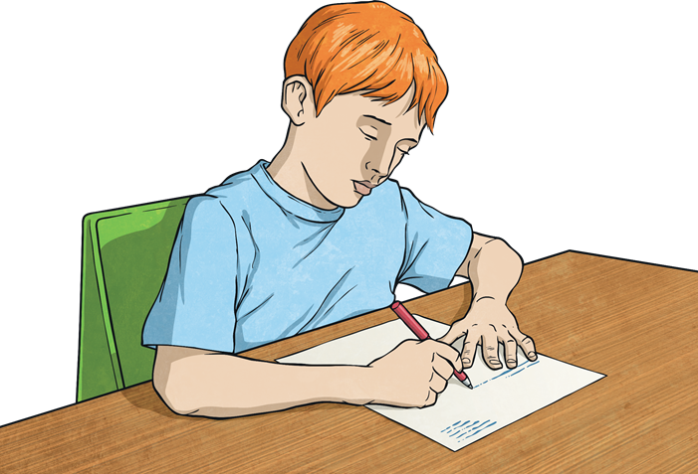
Your Turn!
Your title is:
An Abandoned Place
Use the images on the next slide for inspiration.
Use your ODCCR planning sheet to help you structure your ideas.
Remember to ‘hook’ your readers into your narrative.
Top Tip:
Try to use a variety of techniques in your writing.

Slide 10
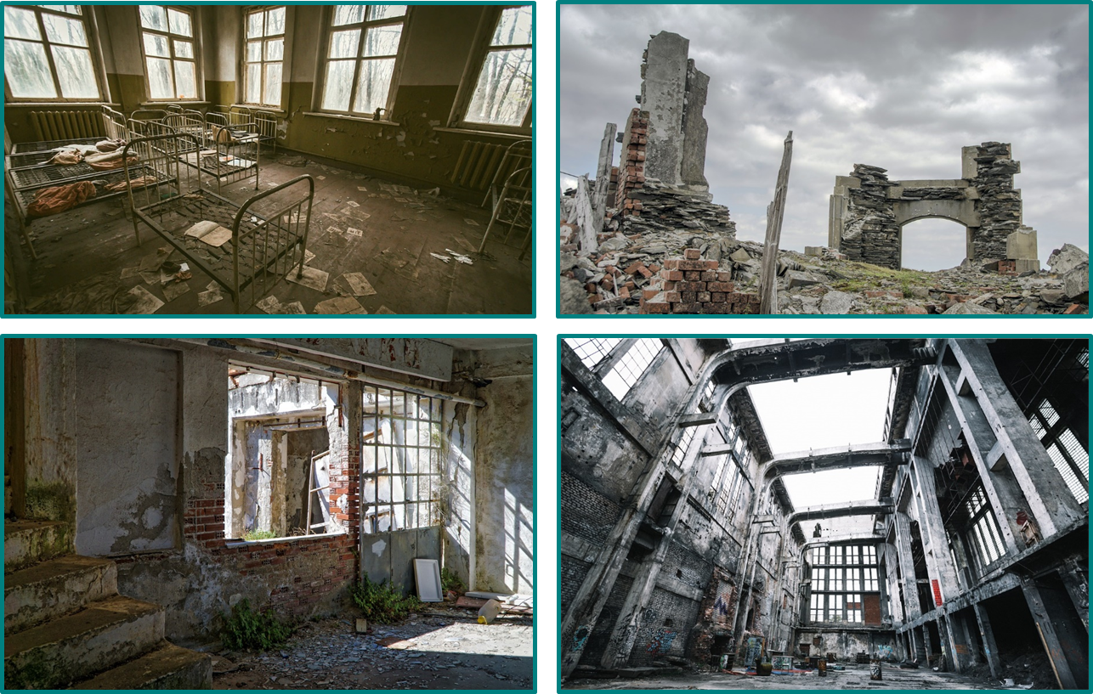
An Abandoned Place

Slide 11
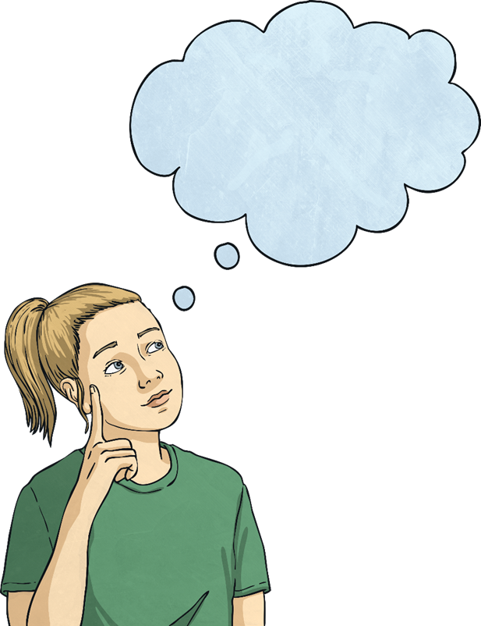
Plenary
Focus on the opening of your partner’s work.
Does it ‘hook’ your interest?
Have they used a variety of techniques?
Is the structure easy to follow?

