Slide 1
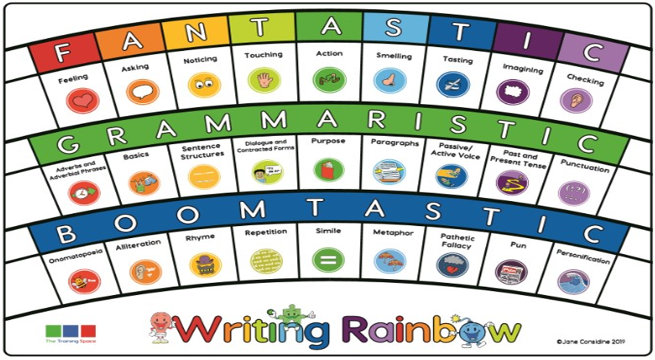
English

Slide 2
LO: To describe my room in the book of Wonders.
The Book of Wonders
Think about what your room will be like behind one of the doors.
Describe it in great detail:
Lenses: noticing, smelling, touching, feeling, imagining.
Then, describe what happens in your room
Lenses: action, (choose lenses relative to your room)
Grammaristics:
Basic, sentence structure, purpose
Once you have completed the writing, draw the room as you have described it. If you want to include something that you haven’t written about, you must go back and add it to your writing! You may shade in your drawing.

Slide 3
Planning a suspense story

Slide 4
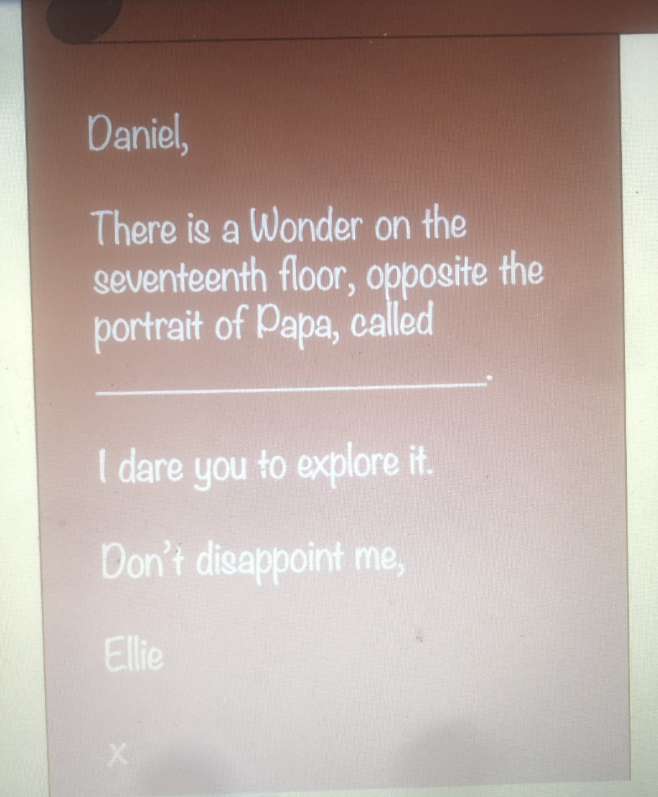

Slide 5
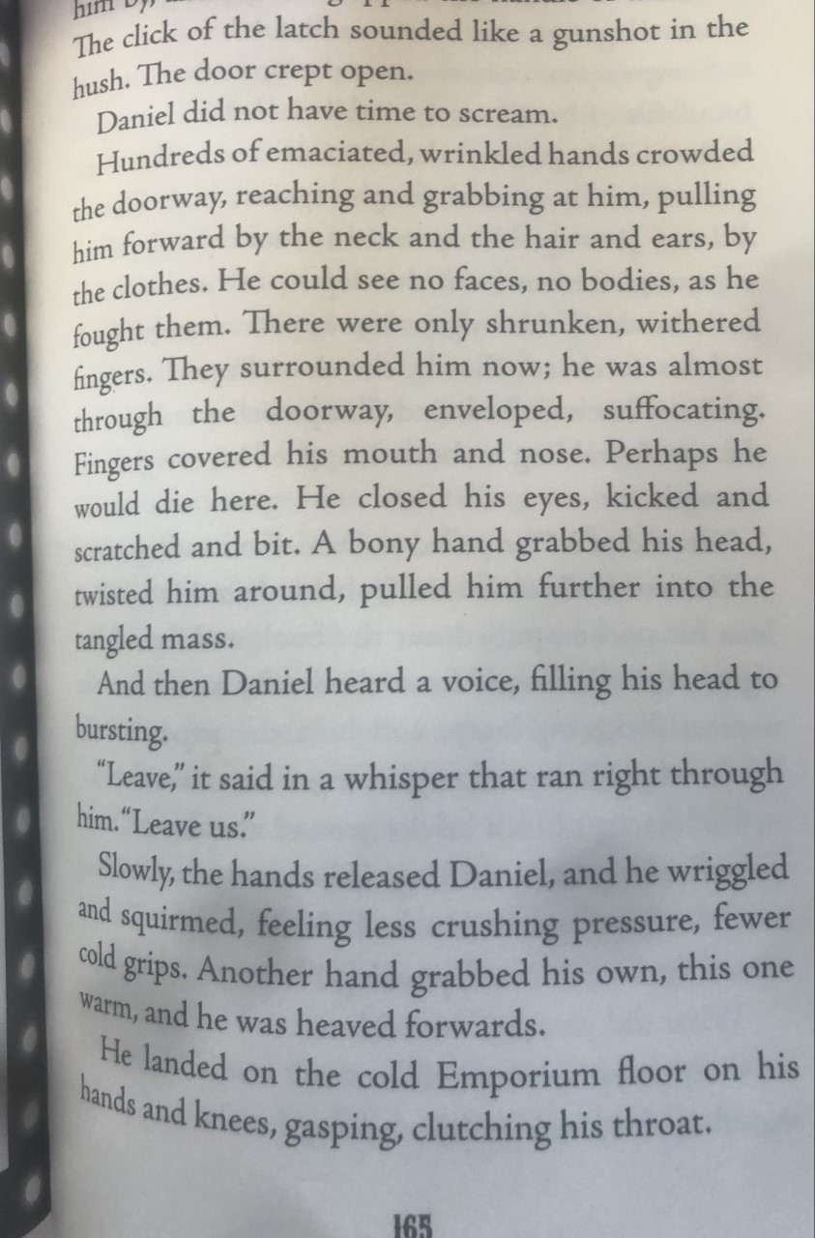
Ross McKenzie’s suspense writing

Slide 6
My Plan (with the focus for each area)
Discover the door; walk through and describe the ‘Wonder’ (allude to something sinister)
Pulled through door handle turned instantly wearing breathing apparatus
Describe the movement of the water, sea-creatures, and any echoing sounds
Discover swimming is easy fro me now and begin to explore
Discover shipwreck
Reveal the danger gradually as the characters discover it… short sentences, rhetorical questions and ellipses
Spot a key and this key to lead me to my danger- magnetic attraction pulling me- twinkling
What lies ahead for me? Feeling
Go towards the door – several doors appear
Mermaids appear and whales (is this a trap? ) do I follow them?

Slide 7
Time Slows… Describe the resolution and exit from the ‘Wonder’. Use expanded noun phrases
Music begins to play- mermaids spin
Whales lurk behind- looming and huge shadows are created
Silhouettes appear (what species are these?)
Feeling when in real danger
The key begins to twinkle
Light protruding from one of the doors
Spies Ellie.

