Slide 1
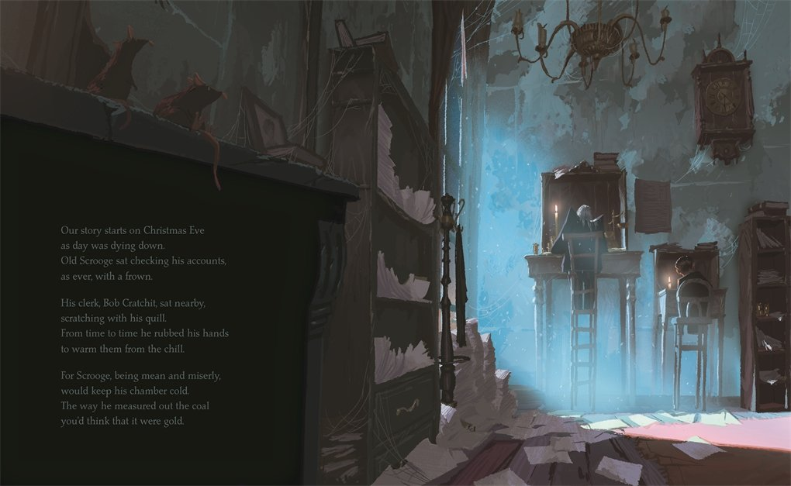
Study this image carefully. What themes could be in this story?
Look at an example of a descriptive story openers from one of your home books.

Slide 2
Write your own story opener; it must be:
Descriptive
Give the reader some clues of what’s to come
Themes of the story should be evident. Eg. Vocabulary should reflect what you think it’s about. (eg a ghost story)
Reread the highlighted parts of the text- how can you integrate these

Slide 3
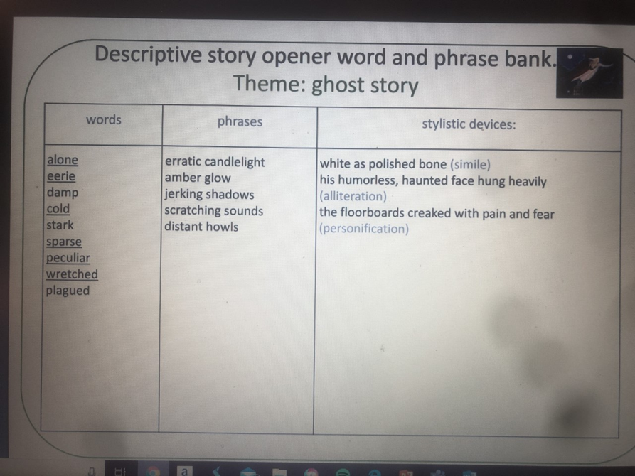
Descriptive openers to help you

