Slide 1




Year 6 - Spring - Block 1
Decimals

Slide 2





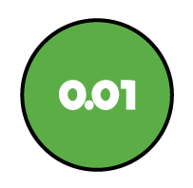

Hundreds | Tens | Ones | Tenths | Hundredths | Thousandths
Tommy says,
Do you agree?
Explain why.
The more decimal places a number has, the smaller the number is.

Slide 3
Hundreds | Tens | Ones | Tenths | Hundredths | Thousandths
Alex says that 3.24 can be written as 2 ones, 13 tenths and 4 hundredths.
Do you agree?
How can you partition 3.24 starting with 2 ones?
How can you partition 3.24 starting with 1 one?
Think about exchanging between columns.

Slide 4
Thousands | Hundreds | Tens | Ones | Tenths | Hundredths
Four children are thinking of four different numbers.
3.454 4.445
4.345 3.54
Teddy: “My number has four hundredths.”
Alex: “My number has the same amount of ones, tenths and hundredths.”
Dora: “My number has less ones that tenths and hundredths.”
Jack: “My number has 2 decimal places.”
Match each number to the correct child.

Slide 5
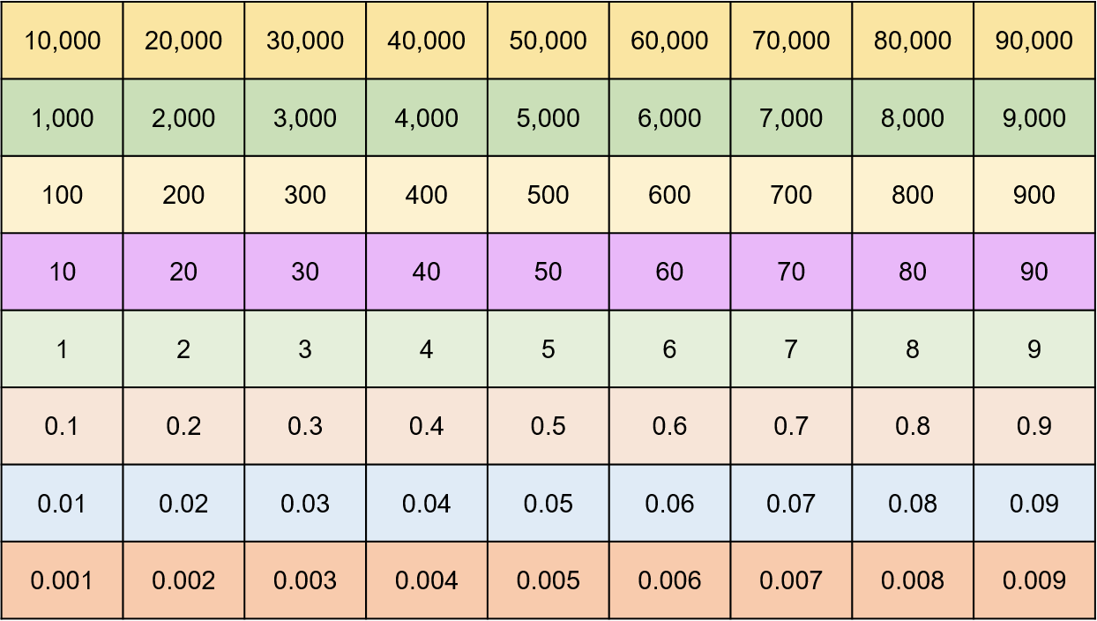
Using the digit cards 0-9 create a number with up to 3 decimal places e.g. 3.451
Cover the number using counters on your Gattegno chart.
Explore what happens when you multiply your number by 10, then 100, then 1,000
What patterns do you notice?

Slide 6
0
1
2
3
4
5
6
7
8
9

Slide 7

Dora says,
Do you agree?
Explain your thinking.
When you multiply by 100, you should add two zeros.

Slide 8
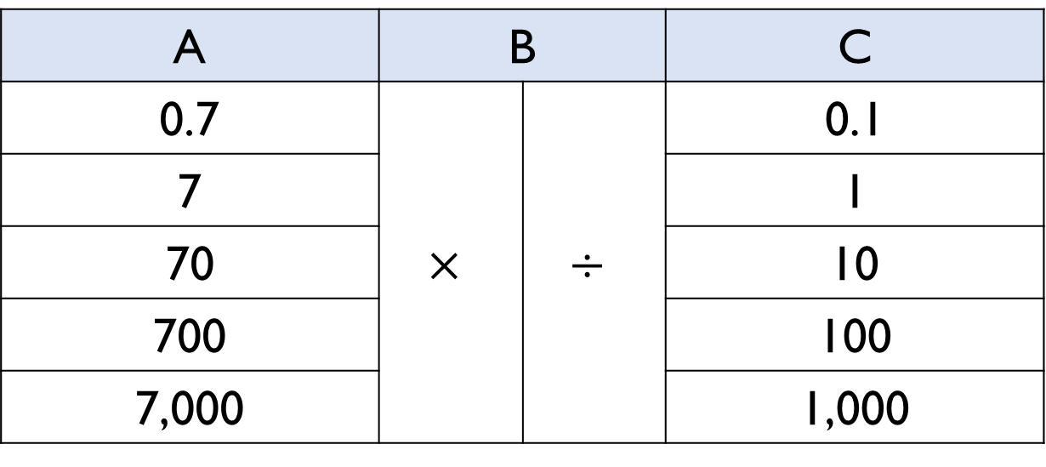
Using the following rules, how many ways can you make 70?
• Use a number from column A
• Use an operation from column B.
• Use number from column C.
A | B |  | C
0.7 | $$×$$ | $$÷$$ | 0.1
7 |  |  | 1
70 |  |  | 10
700 |  |  | 100
7,000 |  |  | 1,000

Slide 9
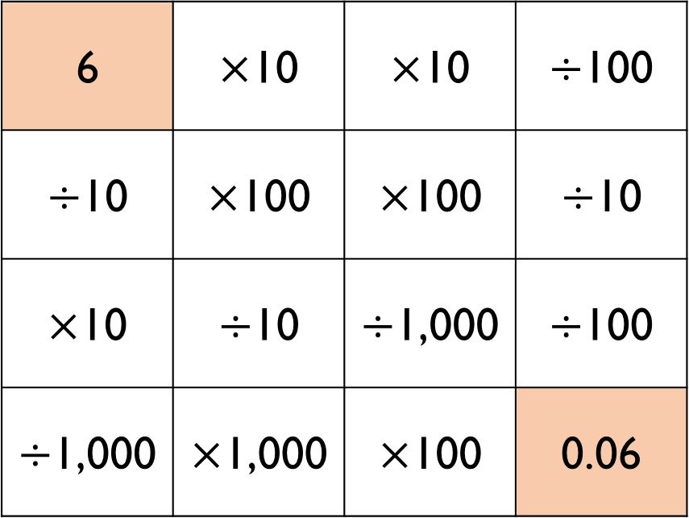
Can you find a path from 6 to 0.06?
You cannot make diagonal moves.
Is there more than one way?
6 | $×$10 | $×$10 | $÷$100
$÷$10 | $×$100 | $×$100 | $÷$10
$×$10 | $÷$10 | $÷$1,000 | $÷$100
$÷$1,000 | $×$1,000 | $×$100 | 0.06

Slide 10

Eva says,
Do you agree?
Explain why.
When you divide by 10, 100 or 1,000 you just take away the zeros or move the decimal point.

Slide 11

Whitney says,
Do you agree?
Explain why.
When you multiply a number with 2 decimal places by an integer, the answer will always have more than 2 decimal places.

Slide 12

Hundreds | Tens | Ones | Tenths | Hundredths | Thousandths
Fill in the blanks.
.
3
4
5
$$×$$
.
0
3
0
.
4
0
.
1
0
0
.

Slide 13

Chocolate eggs can be bought in packs of 1, 6 or 8
What is the cheapest way for Dexter to buy 25 chocolate eggs?
1 chocolate egg
52p
6 chocolate eggs £2.85
8 chocolate eggs
£4

Slide 14

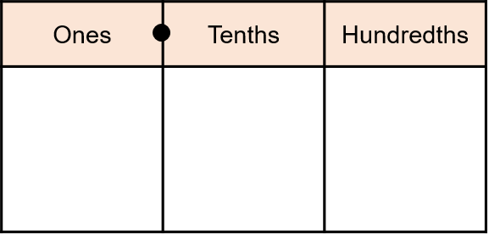



Hundreds | Tens | Ones | Tenths | Hundredths | Thousandths
When using the counters to answer 3.27 divided by 3, this is what Tommy did:
Tommy says,
Do you agree with what Tommy has done? Explain why.
I only had 2 counters in the tenths column, so I moved one of the hundredths so each column could be grouped in 3s.

Slide 15
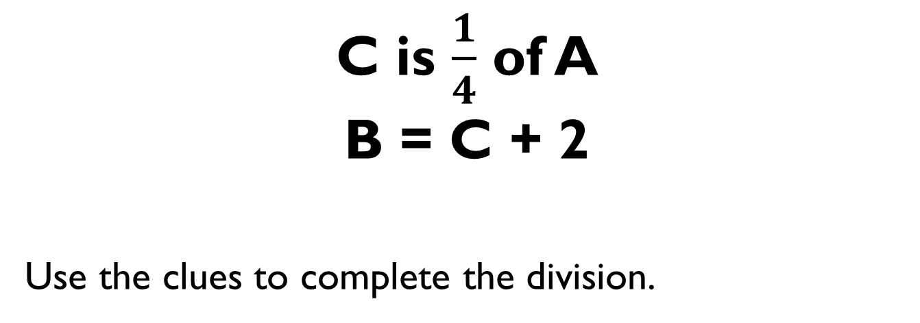
C is $\frac{1}{4}$ of A
B = C + 2
Use the clues to complete the division.
0
B
B
A
C
C
B
C
2

Slide 16
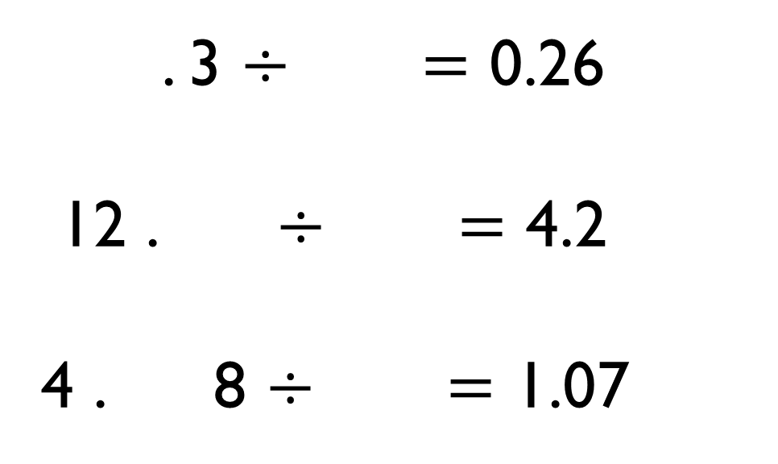
Each division sentence can be completed using the digits below.
1
2
3
4
5
6
. 3 $÷$ $=$ 0.26
12 . $÷$ $=$ 4.2
4 . 8 $÷$ $=$ 1.07

Slide 17


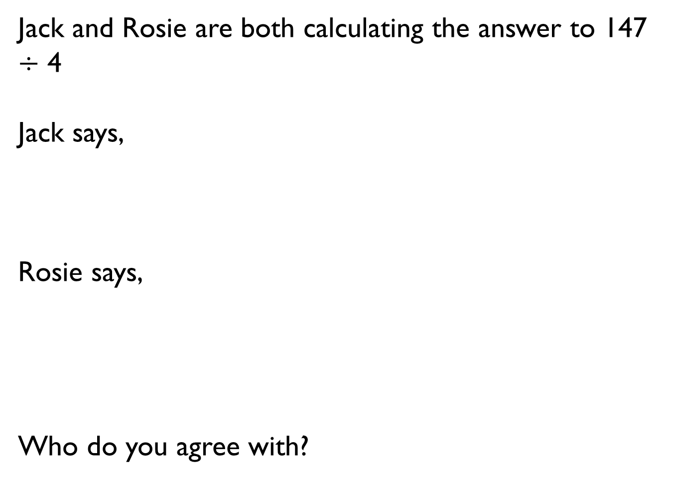
Jack and Rosie are both calculating the answer to 147 $÷$ 4
Jack says,
Rosie says,
Who do you agree with?
The answer is 36 remainder 3
The answer is 36.75

Slide 18


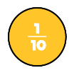
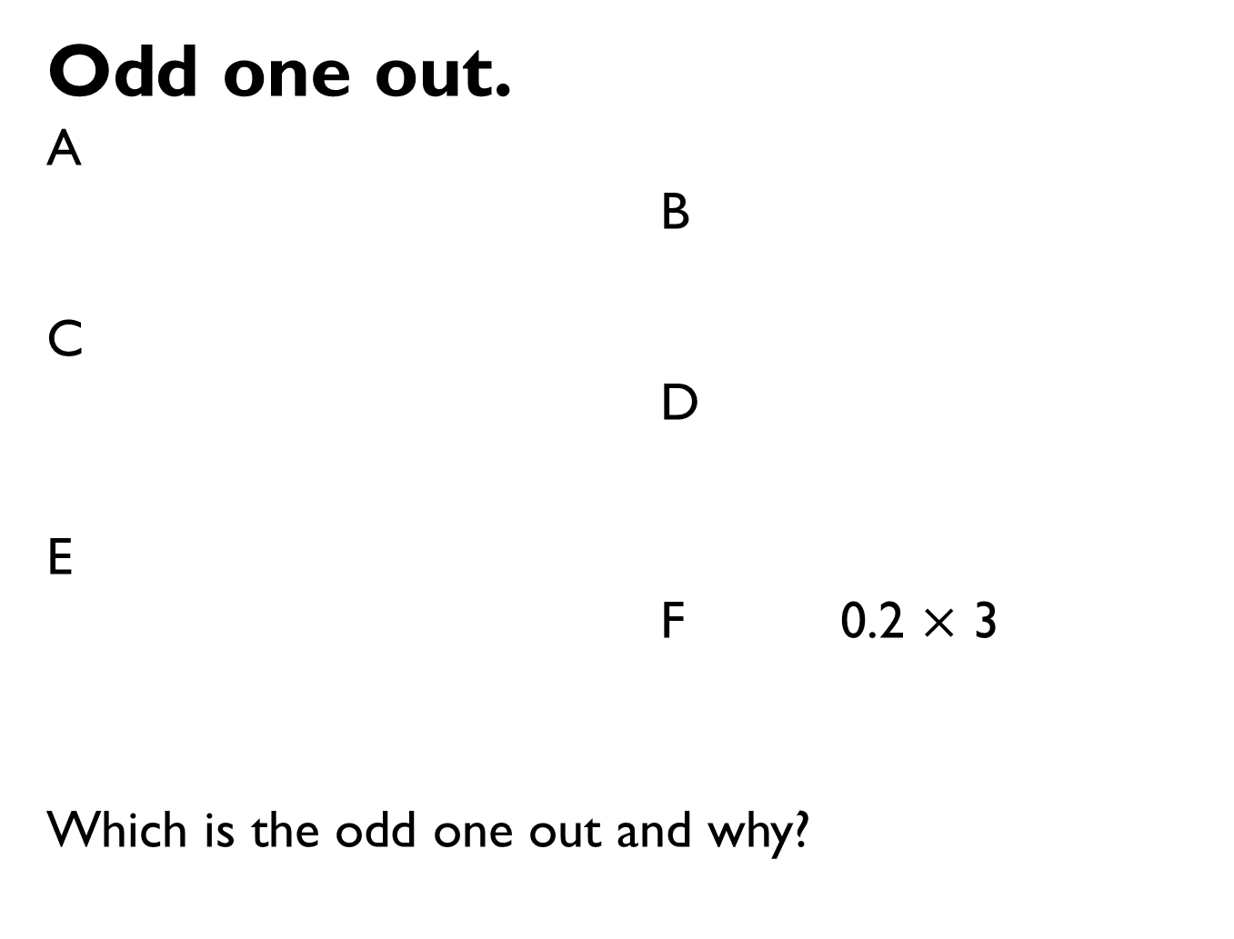
0
1
Odd one out.
A
B
C
D
E
F 0.2 $×$ 3
Which is the odd one out and why?
0
0.1
0.2
0.3
0.4
0.5

Slide 19

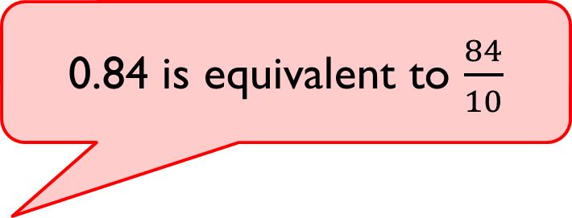
Alex says,
Do you agree?
Explain why.
0.84 is equivalent to $\frac{84}{10}$

Slide 20


Amir says,
Teddy says,
Who do you agree with?
Explain your answer.
The decimal 0.42 can be read as ‘four tenths and two hundredths’.
The decimal 0.42 can
be read as ‘forty-two
hundredths’.

Slide 21
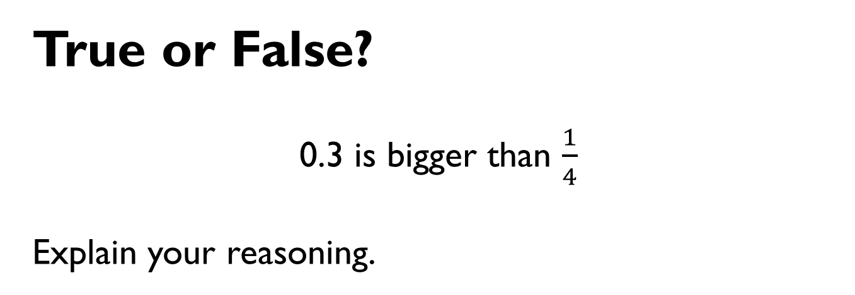
True or False?
0.3 is bigger than $\frac{1}{4}$
Explain your reasoning.

Slide 22
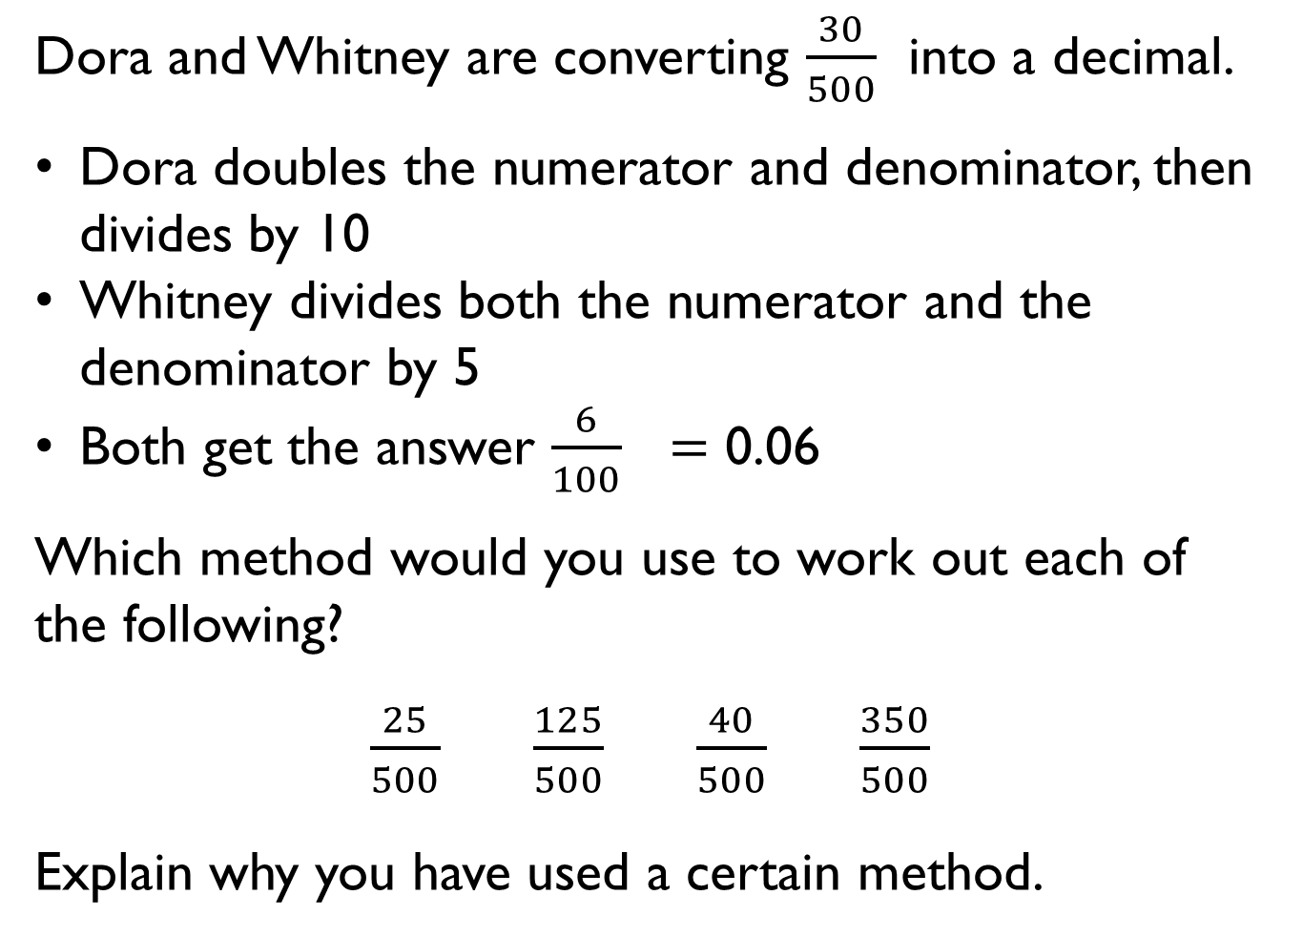
Dora and Whitney are converting $\frac{30}{500}$ into a decimal.
Dora doubles the numerator and denominator, then divides by 10
Whitney divides both the numerator and the denominator by 5
Both get the answer $\frac{6}{100}$ $=$ 0.06
Which method would you use to work out each of the following?
$\frac{25}{500}$ $\frac{125}{500}$ $\frac{40}{500}$ $\frac{350}{500}$
Explain why you have used a certain method.

Slide 23

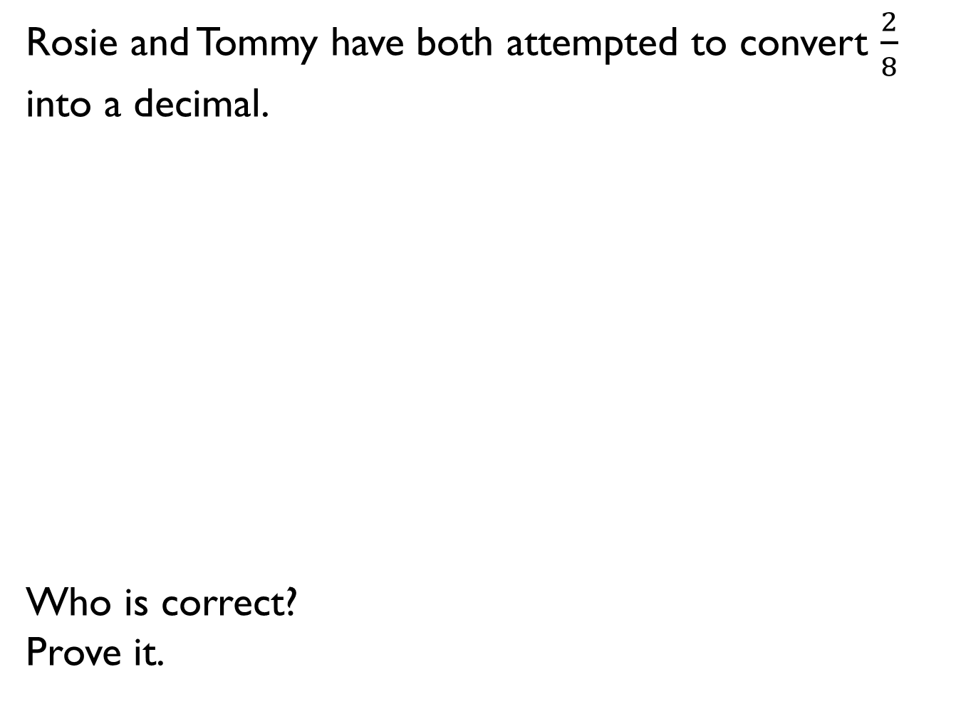
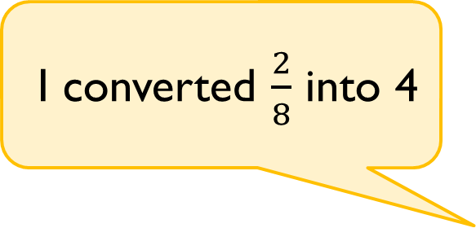
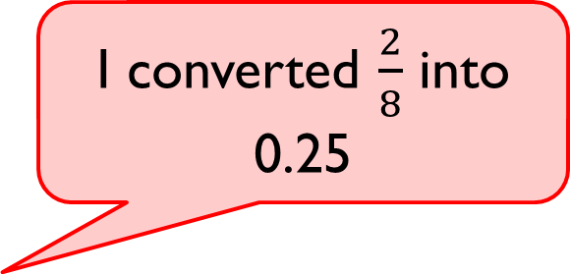
Rosie and Tommy have both attempted to convert $\frac{2}{8}$ into a decimal.
Who is correct?
Prove it.
I converted $\frac{2}{8}$ into 0.25
I converted $\frac{2}{8}$ into 4

Slide 24





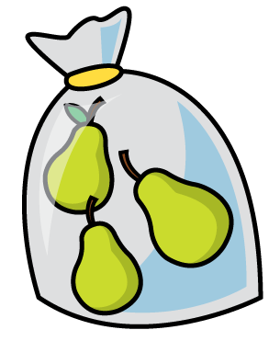





Mo shares 6 bananas between some friends.
Each friend gets 0.75 of a banana.
How many friends does he share the bananas with?
Show your method.

