Slide 1

International day for women and girls in Science
11th February

Slide 2
Task
To pick one of the scientists/engineers below. You could pick one at random. There are 6 to choose from.
Next choose one of the 6 options on the ‘Women in Science’ WORD document.
Complete the task in the allocated time.
Upload your work onto TEAMS. Ask your teacher where and how.

Slide 3
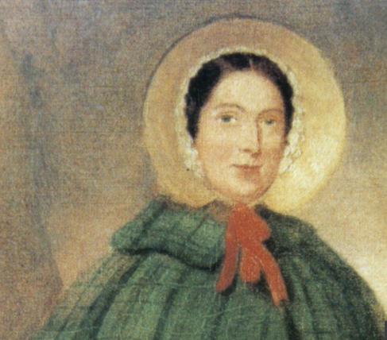
Mary Anning (1799 - 1847)
Palaeontologist
Born: Dorset, England
The Natural History Museum calls her the "unsung hero of fossil discovery", as the scientific community was reluctant to recognise her contributions to science during her lifetime. This is because her discoveries went against the idea that ‘God created everything/creationism. And the fact she was a woman.
.
Discovered Jurassic remains in her hometown of Lyme Regis in Dorset, UK.
She came across her first find - an ancient reptile later named an Ichthyosaurus - at the age of 12.
She was not allowed to be part of the Geological Society of London, for example. In fact, it did not admit women until more than half a century after her death.
Want to know more?
https://www.youtube.com/watch?v=a-CW0B4YeBQ

Slide 4
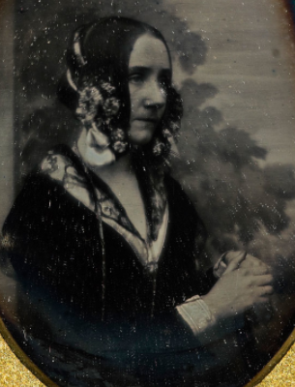
Ada Lovelace (1815 - 1852)
Mathematician
Born: London, England
.
.
Ada Lovelace was a leading 19th century mathematician credited with creating early computer programs. She worked with her friend Charles Babbage, on his proposals for an "Analytical Engine".
The device was never built, but the design had the essential elements of a modern computer. Her notes described how codes could be created
.
Her contributions to the field of computer science were not discovered until the 1950s. Since then, Ada has received many posthumous honors for her work. In 1980, the U.S. Department of Defense named a newly developed computer language "Ada," after Lovelace.
.
In those days, there were no places for girls in the United Kingdom’s universities.
However, girls from wealthy, aristocratic families could be educated to a high level by private tutors. And this is how Ada was educated.
Want to know more?
https://youtu.be/xiZozgCLHc4

Slide 5
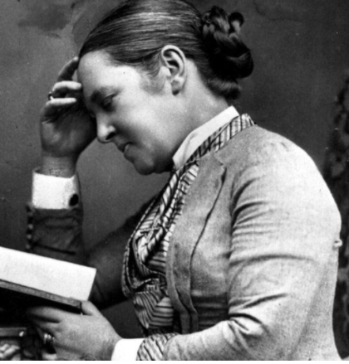
Elizabeth Garrett Anderson (1836 - 1917)
Doctor
Born: London, England
Garrett Anderson was the first woman to qualify in the UK as a doctor - but it wasn't easy to get there.
In her mid-20s, she enrolled as a nurse at the Middlesex Hospital in London.
She attended lectures and observed the male medical students, but no university would let her take the exams to become a doctor.
.
She subsequently opened the St Mary's Dispensary for Women and Children in London and co-founded the London School of Medicine for Women.
Her determination paved the way for other women to become doctors.
.
No British university would let her take the exams to become a doctor. She learnt French and studied to be a doctor in France. Here she gained her medical degree. But the British medical register refused to recognise her qualification
Want to know more?
https://www.youtube.com/watch?v=uUgPKl4dy4I

Slide 6
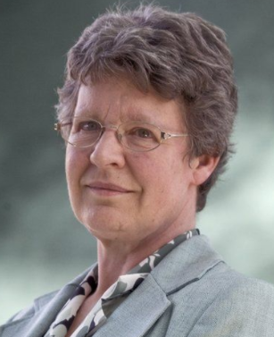
Jocelyn Bell Burnell (1943 -)
Astrophysicist
Born: Lurgan, Northern Ireland
Professor Dame Jocelyn Bell Burnell is credited with one of the most important discoveries of the last century: the discovery of radio pulsars.
Pulsars are the by-products of supernova explosions that make all life possible.
.
She was awarded the Michael Faraday Prize (2010) and a Royal Medal (2015) by the Royal Society
A portrait of Dame Jocelyn Bell-Burnell has been unveiled by the Royal Society in London
.
A leading astrophysicist, who was once overlooked for a Nobel prize in 1974 in favour of her male collaborators, has now taken her "rightful place" among the world's most distinguished scientists.
Want to know more?
https://scientificwomen.net/women/bell-jocelyn-14

Slide 7
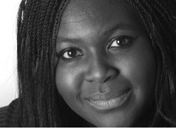
Dr Maggie Aderin-Pocock MBE – Space Scientist
Born 9 March 1968. Islington,London
Dr Maggie Aderin-Pocock, MBE is Space Scientist and science educator.
Co-presented the long-running astronomy TV programme The Sky at Night.
“When I got my MBE, the Queen asked me what I did in life. When I told her that I was a space scientist, she was physically shocked…
.
Has dyslexia. She has the ability to think differently due to her dyslexia.
Want to know more?
https://www.youtube.com/watch?v=xhJiC-ieXAg

Slide 8
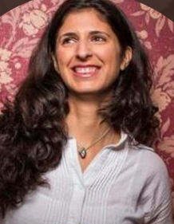
Nina Tandon
1980. America, New York
She is a biomedical tissue engineer. She engineers the growth of bones for skeletal reconstruction. This allows the repair bone defects in people by using the patient’s stem cells to grow new healthy bones in a lab environment. They can be made to exact measurements to reflect the patient’s body. It also means that the patient’s immune system will naturally accept the new bone, rather than fighting against it.
.
She is the founder and CEO of EpiBone
Tandon has also been involved with constructing beating hearts
Want to know more?
https://www.nbcnews.com/video/discovering-you-nina-tandon-82230853524

Slide 9
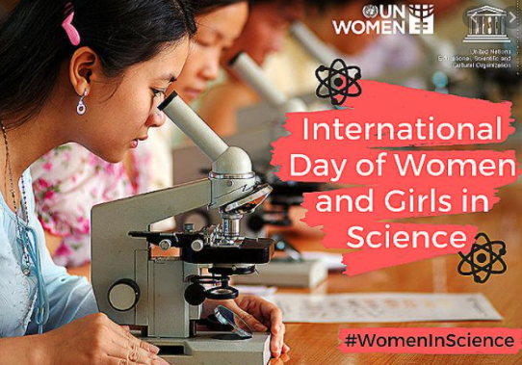
11th Feb international day for women and girls in science
INSPIRED? FINISHED?
Here are some other websites that you can use to look into women and girls impact in the world of science.
A collection of printable posters
https://insidetheperimeter.ca/forces-of-nature-great-women-who-changed-science/
A time line of women in science
https://stfc.ukri.org/files/a-brief-history-of-women-in-science/
Further links and more awesome bits of information
https://www.teachervision.com/women-stem

