Slide 1




Year 6 - Spring - Block 2
Percentages

Slide 2
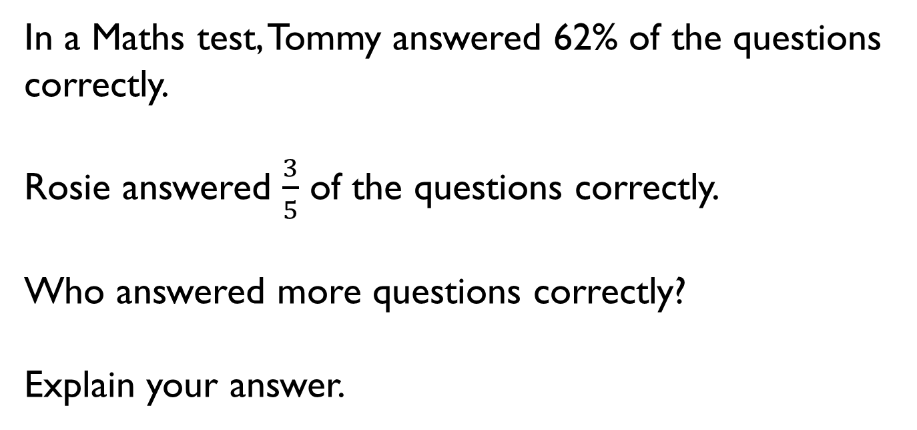
In a Maths test, Tommy answered 62% of the questions correctly.
Rosie answered $\frac{3}{5}$ of the questions correctly.
Who answered more questions correctly?
Explain your answer.

Slide 3
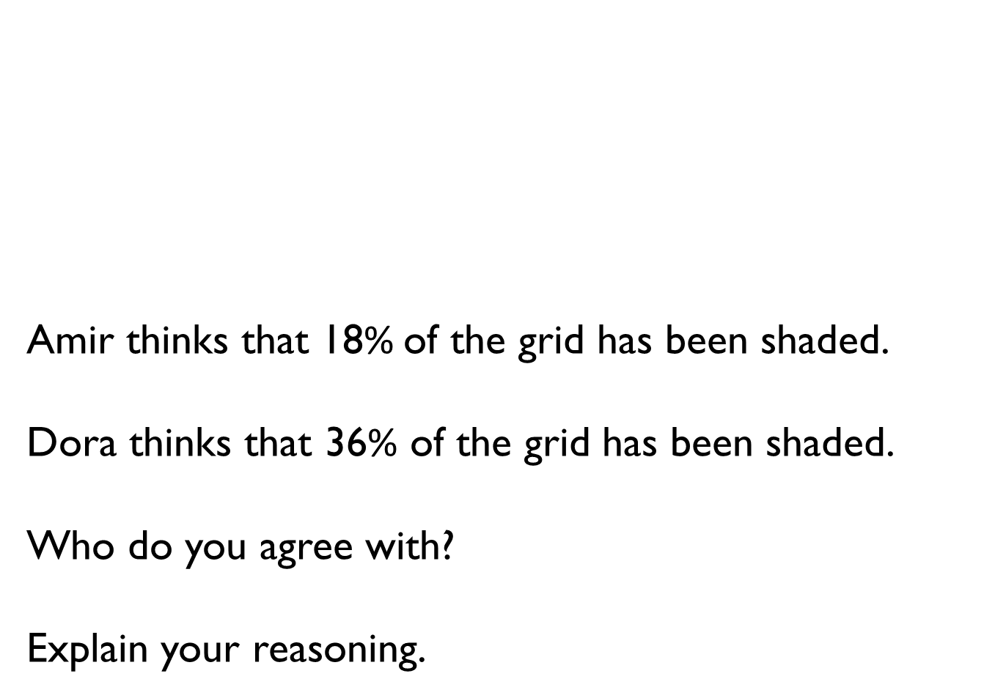
Amir thinks that 18% of the grid has been shaded.
Dora thinks that 36% of the grid has been shaded.
Who do you agree with?
Explain your reasoning.

Slide 4
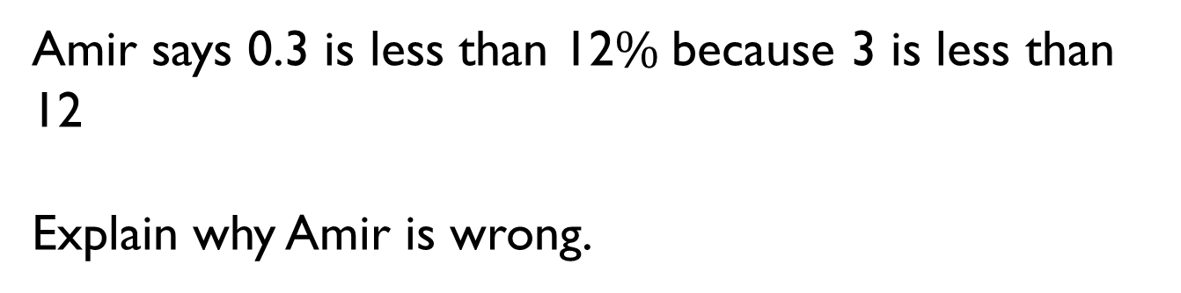
Amir says 0.3 is less than 12$\%$because 3 is less than 12
Explain why Amir is wrong.

Slide 5
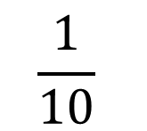
Complete the part-whole model.
How many different ways can you complete it?
Can you create your own version with different values?
$$\frac{1}{10}$$
A
10%
100%
B
0.7
C

Slide 6
How many different fractions can you make using the digit cards?
How many of the fractions can you convert into decimals and percentages?
1
2
3
4
5
6

Slide 7
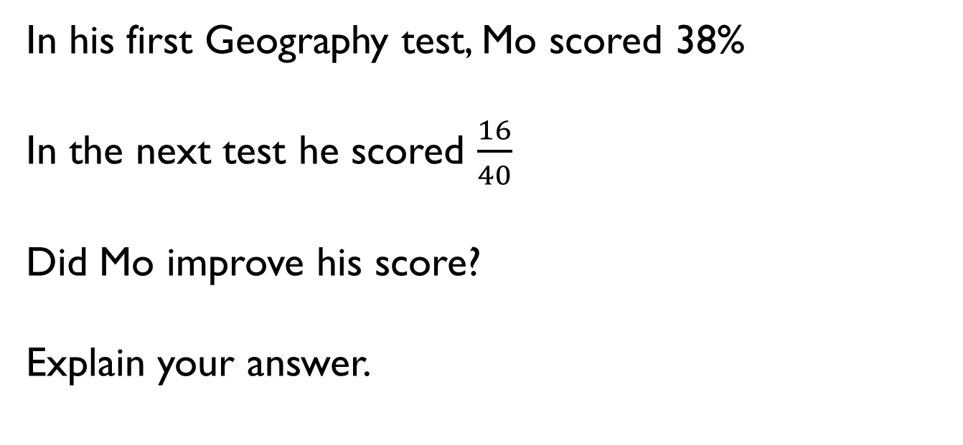
In his first Geography test, Mo scored 38%
In the next test he scored $\frac{16}{40}$
Did Mo improve his score?
Explain your answer.

Slide 8





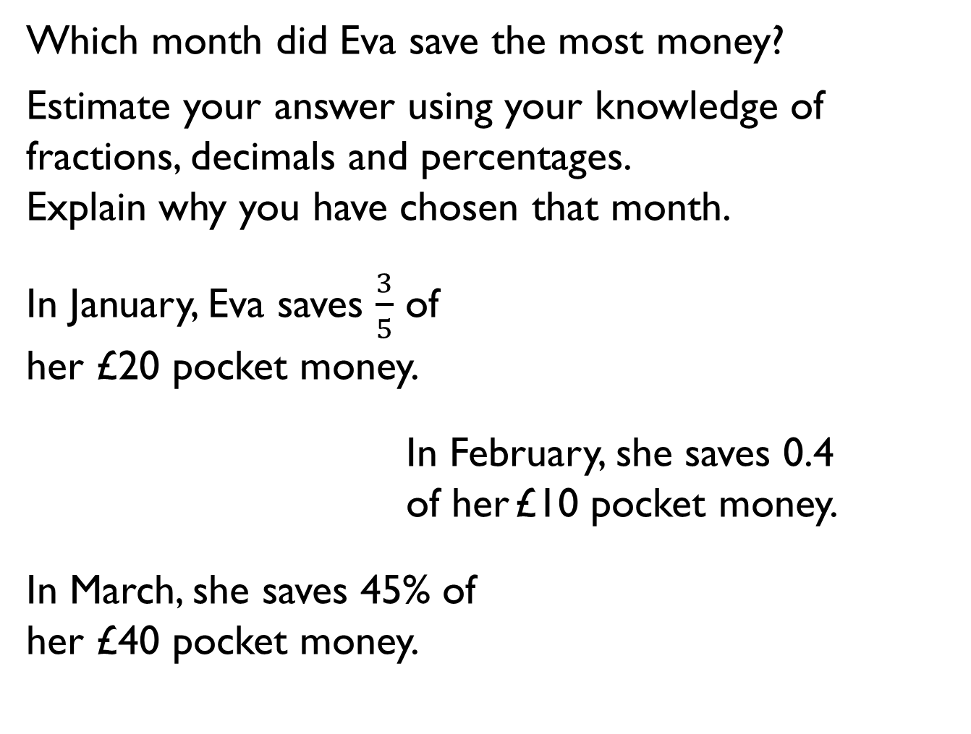
Which month did Eva save the most money?
Estimate your answer using your knowledge of fractions, decimals and percentages.
Explain why you have chosen that month.
In January, Eva saves $\frac{3}{5}$ of
her £20 pocket money.
In February, she saves 0.4 of her £10 pocket money.
In March, she saves 45% of
her £40 pocket money.

Slide 9

Mo says,
Do you agree? Explain why.
To find 10% you divide by 10, so to find 50% you divide by 50
0%
10%
20%
30%
40%
50%
60%
70%
80%
90%
100%

Slide 10
Eva says to find 1% of a number, you divide by 100
Whitney says to find 1% of a number, you divide by 10 and then by 10 again.
Who do you agree with?
Explain your answer.

Slide 11
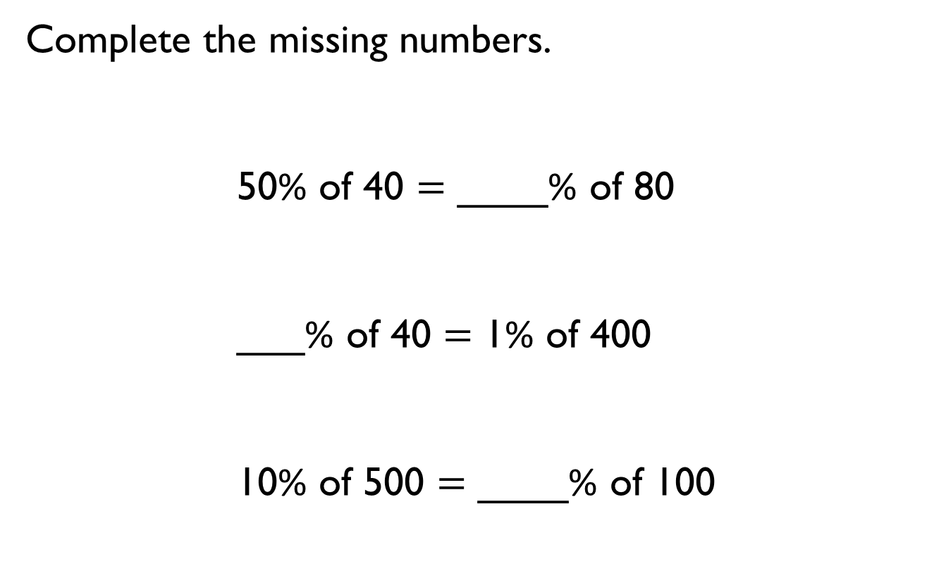
Complete the missing numbers.
50% of 40 $=$ ____% of 80
___% of 40 $=$ 1% of 400
10% of 500 $=$ ____% of 100

Slide 12




Four children were asked to find 20% of an amount.
Whitney
Amir
Alex
Jack
Who do you think has the most efficient method? Explain why.
Who do you think will end up getting the answer incorrect?
I divided by 5 because 20% is the same as one fifth
I found one percent by dividing by 100, then I multiplied my answer by 20
I did 10% add 10%
I found ten percent by dividing by 10, then I multiplied my answer by 2

Slide 13
How many ways can you find 45% of 60?
Use similar strategies to find 60% of 45
What do you notice?
Does this always happen?
Can you find more examples?

Slide 14
What percentage questions can you ask about this bar model?
3.5

Slide 15
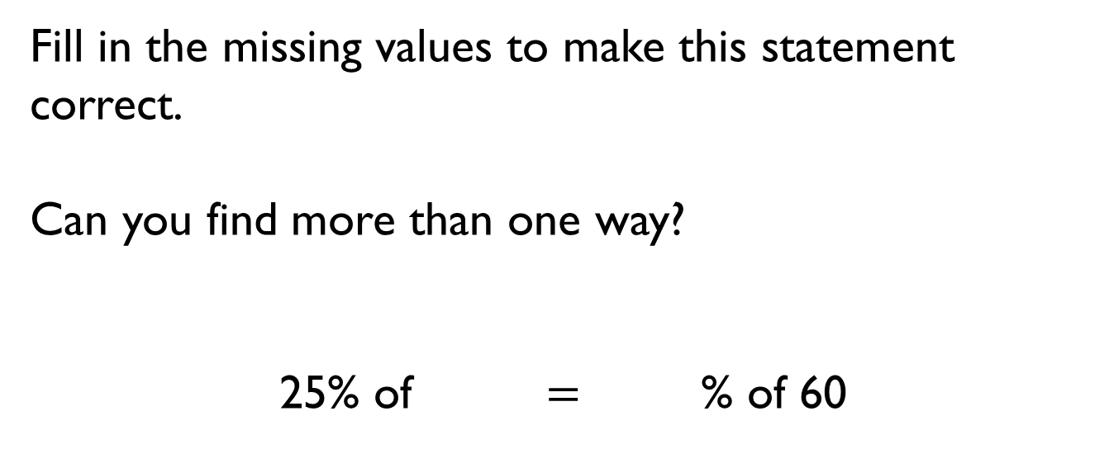
Fill in the missing values to make this statement correct.
Can you find more than one way?
25% of $=$ % of 60

Slide 16
A golf club has 200 members.
58% of the members are male.
50% of the female members are children.
How many male members are in the golf club?
How many female children are in the golf club?

