Slide 2
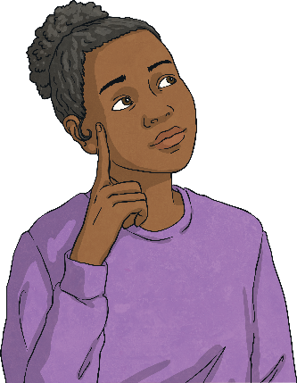
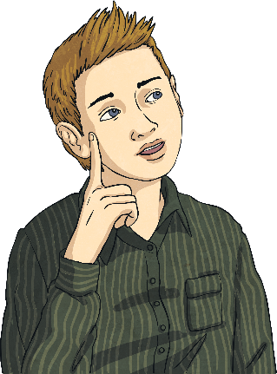
Fractions
Use common factors to simplify fractions
Use common multiples to express fractions in
the same denomination
Compare and order fractions, including fractions > 1
Add and subtract fractions with different denominators and mixed numbers
Multiply simple pairs of proper fractions, writing the answer in its simplest form
Divide proper fractions
by whole numbers
Calculate fractions
of an amount
Calculate decimal
equivalents of fractions

Slide 3
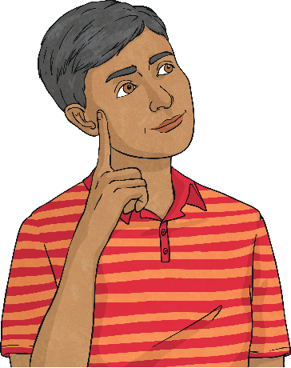

Decimals and Percentages
Identify the value of each digit in numbers to three decimal places
Order and compare
numbers with up to
three decimal places
Multiply one-digit numbers with up to two decimal places by whole numbers
Use written division methods in cases where the answer has up to two decimal places
Round decimal numbers
to specified degrees
of accuracy
Recall and use equivalences between simple fractions, decimals and percentages

Slide 4
Revise
Use common factors to simplify fractions
Fractions which have the same value, but represent this value using different denominators and numerators, are equivalent. We can recognise and find equivalent fractions by multiplying or dividing the numerator and denominator by the same amount.
When we simplify a fraction, we use the highest common factor of the numerator and denominator to reduce the fraction to the lowest term equivalent fraction (simplest form).
15
36
Factors of 15:
1
15
3
5
The highest common factor is 3.
Factors of 36:
1
36
2
18
3
12
4
9
6
15
36
÷ 3 = 5
5
12
=
÷ 3 = 12

Slide 5
Quiz
Use common factors
to simplify fractions
What is the highest common factor of the numerator and denominator in this fraction?
24
60
8
12
6
3
Correct!
Try again!

Slide 6
Quiz
Use common factors
to simplify fractions
Simplify this fraction to its lowest terms.
18
72
4
8
2
8
1
4
3
9
Correct!
Try again!

Slide 7
Quiz
Use common factors
to simplify fractions
Which number completes this equivalent fraction sequence?
1
14
2
28
3
42
4
?
56
52
55
54
Correct!
Try again!

Slide 8
Quiz
Use common factors
to simplify fractions
Which number completes this equivalent fraction pair?
27
99
3
?
12
18
9
11
Correct!
Try again!
Choose another objective

Slide 9
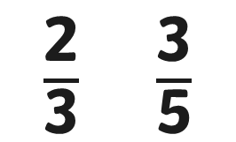
Revise
Use common multiples to express fractions in the same denomination
To compare or calculate with fractions, we often need to give them a common denominator.
We do this by looking at the denominators and finding their lowest common multiple.
$\frac{\text{2}}{\text{3}}$ $\frac{\text{3}}{\text{5}}$
We can now change the fractions to have a common denominator of 15 using multiplication.
3, 6, 9, 12, 15
5, 10, 15, 20, 25
2
3
× 5 = 10
3
5
× 3 = 9
Remember that whatever we do to the denominator, we have to do to the numerator.
× 5 = 15
× 3 = 15

Slide 10
Quiz
Use common multiples to express fractions in the same denomination
What is the lowest common denominator of these two fractions?
5
12
7
30
48
120
60
90
Correct!
Try again!

Slide 11
Quiz
Use common factors
to simplify fractions
What is the lowest common denominator
of these two fractions?
5
14
2
3
42
28
21
45
Correct!
Try again!

Slide 12
Quiz
Use common factors
to simplify fractions
Express these fractions using the lowest common denominator.
7
16
3
5
7
16 15
16
4
40
24
40
11
20
12
20
35
80
48
80
Try again!
Correct!

Slide 13
Quiz
Use common multiples to express fractions in the same denomination
What is the lowest common denominator of these two fractions?
11
24
13
18
4
90
5
90
11
3
13
3
33
72
52
72
11
8
13
8
Correct!
Try again!
Choose another objective

Slide 14



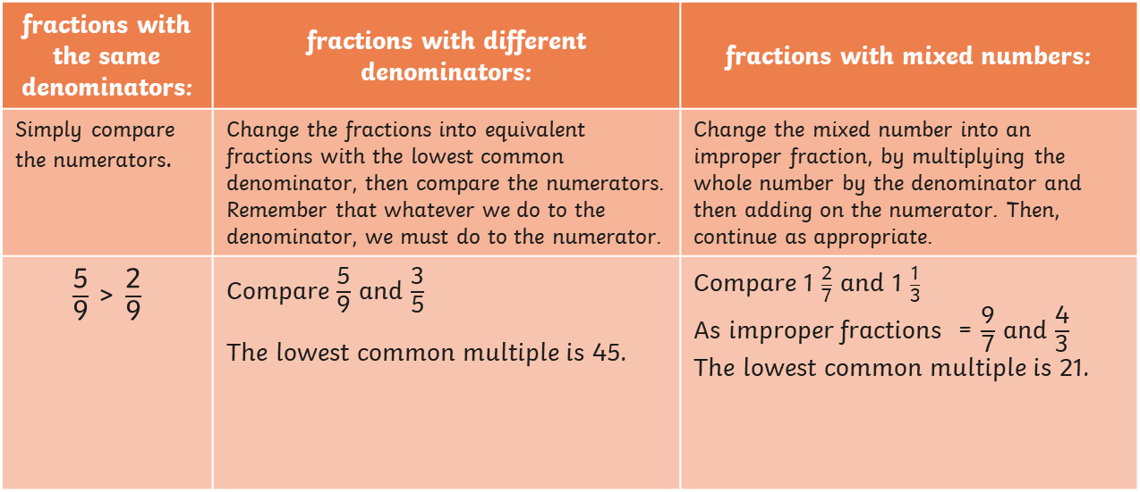



Revise
Compare and order fractions, including fractions > 1
We can order and compare fractions. When comparing fractions, we can use symbols to show which is the smaller or the larger fraction.
<
is less than
>
is greater than
To compare and order…
fractions with the same denominators: | fractions with different denominators: | fractions with mixed numbers:
Simply compare the numerators. | Change the fractions into equivalent fractions with the lowest common denominator, then compare the numerators. Remember that whatever we do to the denominator, we must do to the numerator. | Change the mixed number into an improper fraction, by multiplying the whole number by the denominator and then adding on the numerator. Then, continue as appropriate.
$\frac{\text{5}}{\text{9}}$ > $\frac{\text{2}}{\text{9}}$ | Compare $\frac{\text{5}}{\text{9}}$ and $\frac{\text{3}}{\text{5}}$ The lowest common multiple is 45. | Compare 1 $\frac{\text{2}}{\text{7}}$ and 1 $\frac{\text{1}}{\text{3}}$ As improper fractions = $\frac{\text{9}}{\text{7}}$ and $\frac{\text{4}}{\text{3}}$ The lowest common multiple is 21.
$\frac{\text{5}}{\text{9}}$ = $\frac{\text{25}}{\text{45}}$
$\frac{\text{3}}{\text{5}}$ = $\frac{\text{27}}{\text{45}}$
$\frac{\text{25}}{\text{45}}$ < $\frac{\text{27}}{\text{45}}$
$\frac{\text{9}}{\text{7}}$ = $\frac{\text{27}}{\text{21}}$
$\frac{\text{4}}{\text{3}}$ = $\frac{\text{28}}{\text{21}}$
$\frac{\text{27}}{\text{21}}$ < $\frac{\text{28}}{\text{21}}$

Slide 15
Quiz
Compare and order fractions, including fractions > 1
Choose the correct symbol to compare these fractions.
5
8
4
7
<
>
Correct!
Try again!

Slide 16
Quiz
Compare and order fractions, including fractions > 1
Choose the correct symbol to compare these fractions.
7
12
3
7
<
>
Correct!
Try again!

Slide 17
Quiz
Compare and order fractions, including fractions > 1
Choose the correct symbol to compare these fractions.
3
4
8
9
1
1
<
>
Correct!
Try again!

Slide 18
Quiz
Compare and order fractions, including fractions > 1
Choose the correct symbol to compare these fractions.
3
5
2
3
1
1
<
>
Correct!
Try again!

Slide 19
Quiz
Compare and order fractions, including fractions > 1
Which of these fractions is the smallest?
13
15
5
6
9
10
Correct!
Try again!

Slide 20
Quiz
Compare and order fractions, including fractions > 1
Which of these fractions is the greatest?
2
5
3
12
1
3
Correct!
Try again!
Choose another objective

Slide 21














Revise
Add and subtract fractions with different denominators and mixed numbers
When we add and subtract fractions with different denominators, we need to give them a common denominator.
We use the lowest common multiple as the common denominator to create equivalent fractions which we can then add and subtract.
If one of the fractions is a multiple of the other, use multiplication to change the smaller denominator to the same denominator as the other fraction. | If the fractions aren’t multiples of each other, use multiplication to change them both to the lowest common denominator.
$\frac{\text{5}}{\text{9}}$ + $\frac{\text{2}}{\text{3}}$ =
$\frac{\text{8}}{\text{9}}$ - $\frac{\text{3}}{\text{4}}$ =
$\frac{\text{5}}{\text{9}}$ + $\frac{\text{2}}{\text{3}}$
×3
$$\frac{\text{6}}{\text{9}}$$
×4
$$\frac{\text{32}}{\text{36}}$$
×9
$$\frac{\text{27}}{\text{36}}$$
=
$$\frac{\text{8}}{\text{9}}$$
=
$$\frac{\text{3}}{\text{4}}$$
=
×3
×4
×9
$\frac{\text{5}}{\text{9}}$ + $\frac{\text{6}}{\text{9}}$ =
$$\frac{\text{11}}{\text{9}}$$
1 $\frac{\text{2}}{\text{9}}$
$\frac{\text{32}}{\text{36}}$ - $\frac{\text{27}}{\text{36}}$ =
$$\frac{\text{5}}{\text{36}}$$
$$=$$

Slide 22












Revise
Add and subtract fractions with different denominators and mixed numbers
If the fractions involve adding or subtracting mixed numbers, there are two methods that can be used.
Add the whole numbers and the fractions separately. | Convert the mixed numbers to improper fractions.
2 $\frac{\text{3}}{\text{5}}$ + 3 $\frac{\text{1}}{\text{4}}$ =
2 $\frac{\text{5}}{\text{6}}$ - 1 $\frac{\text{1}}{\text{5}}$ =
2 + 3 = 5
$\frac{\text{17}}{\text{6}}$ - $\frac{\text{6}}{\text{5}}$
=
$\frac{\text{85}}{\text{3}\text{0}}$ - $\frac{\text{36}}{\text{3}\text{0}}$
$$\frac{\text{49}}{\text{3}\text{0}}$$
$\frac{\text{3}}{\text{5}}$ + $\frac{\text{1}}{\text{4}}$
=
$\frac{\text{12}}{\text{20}}$ + $\frac{\text{5}}{\text{20}}$
$$\frac{\text{1}\text{7}}{\text{20}}$$
=
=
5 + $\frac{\text{17}}{\text{20}}$ =
5 $\frac{\text{17}}{\text{20}}$
$\frac{\text{49}}{\text{30}}$ =
1 $\frac{\text{19}}{\text{30}}$

Slide 23
Quiz
Add and subtract fractions with different denominators and mixed numbers
What is the answer to this fraction addition?
4
9
2
5
+
6
14
6
45
38
45
Correct!
Try again!

Slide 24
Quiz
Add and subtract fractions with different denominators and mixed numbers
What is the answer to this fraction addition?
5
8
4
7
+
9
56
11
56
10
56
1
1
1
Correct!
Try again!

Slide 25
Quiz
Add and subtract fractions with different denominators and mixed numbers
What is the answer to this fraction subtraction?
8
9
3
4
-
5
36
5
5
24
36
Correct!
Try again!

Slide 26
Quiz
Add and subtract fractions with different denominators and mixed numbers
What is the answer to this fraction subtraction?
1
3
5
-
1
9
21
40
19
40
20
40
1
1
1
Correct!
Try again!
Choose another objective

Slide 27
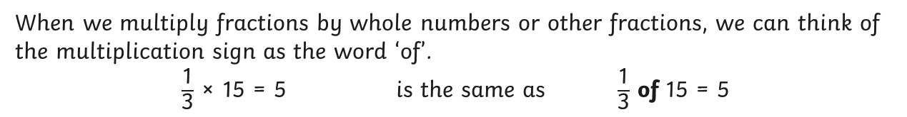
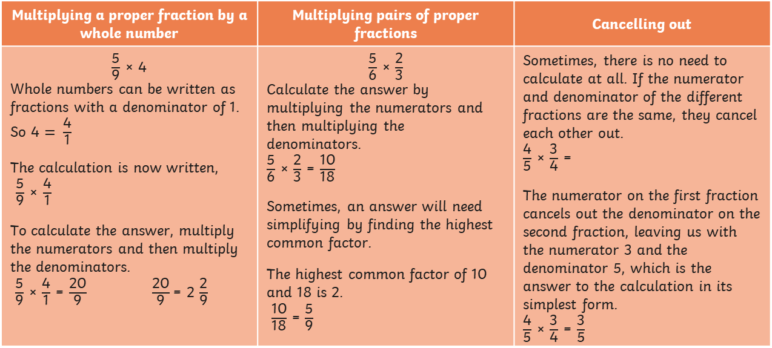
Revise
Multiply simple pairs of proper fractions, writing the answer in its simplest form
When we multiply fractions by whole numbers or other fractions, we can think of the multiplication sign as the word ‘of’.
$\frac{\text{1}}{\text{3}}$ × 15 = 5 is the same as $\frac{\text{1}}{\text{3}}$ of 15 = 5
Multiplying a proper fraction by a whole number | Multiplying pairs of proper fractions | Cancelling out
$\frac{\text{5}}{\text{9}}$ × 4 Whole numbers can be written as fractions with a denominator of 1. So 4 $= \frac{\text{4}}{\text{1}}$ The calculation is now written, $\frac{\text{5}}{\text{9}}$ × $\frac{\text{4}}{\text{1}}$ To calculate the answer, multiply the numerators and then multiply the denominators. $\frac{\text{5}}{\text{9}}$ × $\frac{\text{4}}{\text{1}}$ = $\frac{\text{20}}{\text{9}}$ $\frac{\text{20}}{\text{9}}$ = 2 $\frac{\text{2}}{\text{9}}$ | $\frac{\text{5}}{\text{6}}$ × $\frac{\text{2}}{\text{3}}$ Calculate the answer by multiplying the numerators and then multiplying the denominators. $\frac{\text{5}}{\text{6}}$ × $\frac{\text{2}}{\text{3}}$ = $\frac{\text{10}}{\text{18}}$ Sometimes, an answer will need simplifying by finding the highest common factor. The highest common factor of 10 and 18 is 2. $\frac{\text{10}}{\text{18}}$ = $\frac{\text{5}}{\text{9}}$ | Sometimes, there is no need to calculate at all. If the numerator and denominator of the different fractions are the same, they cancel each other out. $\frac{\text{4}}{\text{5}}$ × $\frac{\text{3}}{\text{4}}$ = The numerator on the first fraction cancels out the denominator on the second fraction, leaving us with the numerator 3 and the denominator 5, which is the answer to the calculation in its simplest form. $\frac{\text{4}}{\text{5}}$ × $\frac{\text{3}}{\text{4}}$ = $\frac{\text{3}}{\text{5}}$

Slide 28
Quiz
Multiply simple pairs of proper fractions, writing the answer in its simplest form
What is the answer to this fraction multiplication?
3
5
1
8
×
3
40
4
40
6
40
Correct!
Try again!

Slide 29
Quiz
Multiply simple pairs of proper fractions, writing the answer in its simplest form
What is the answer to this fraction multiplication?
8
9
5
6
×
45
54
20
27
20
54
Correct!
Try again!

Slide 30
Quiz
Multiply simple pairs of proper fractions, writing the answer in its simplest form
What is the answer to this fraction multiplication?
3
8
2
3
×
8
24
2
6
1
4
Correct!
Try again!
Choose another objective

Slide 31

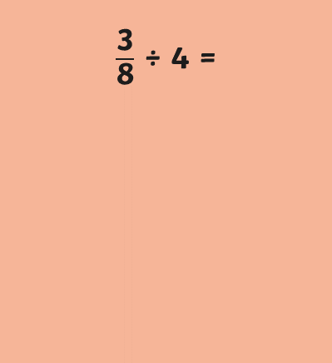

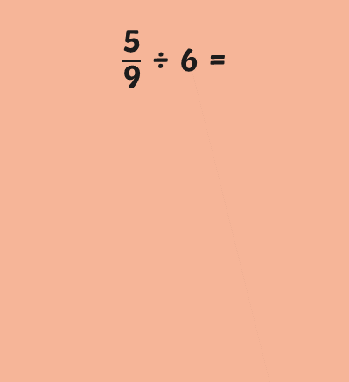



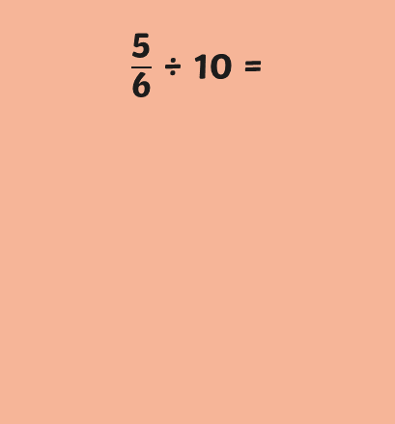

Revise
Divide proper fractions
by whole numbers
Multiplication and division are inverse operations of each other.
÷ 5 is the same as × $\frac{\text{1}}{\text{5}}$ ÷ 7 is the same as × $\frac{\text{1}}{\text{7}}$ ÷ 10 is the same as × $\frac{\text{1}}{\text{10}}$
When we divide a proper fraction by a whole number, we actually use multiplication.
$\frac{\text{5}}{\text{9}}$ ÷ 6 =
$\frac{\text{3}}{\text{8}}$ ÷ 4 =
$\frac{\text{5}}{\text{6}}$ ÷ 10 =
$\frac{\text{5}}{\text{9}}$ × $\frac{\text{1}}{\text{6}}$ =
$\frac{\text{3}}{\text{8}}$ × $\frac{\text{1}}{\text{4}}$ =
$\frac{\text{5}}{\text{6}}$ × $\frac{\text{1}}{\text{10}}$ =
$\frac{\text{5 }\text{×}\text{ 1}}{\text{9 }\text{×}\text{ 6}}$ = $\frac{\text{5}}{\text{54}}$
$\frac{\text{3} \text{×}\text{ 1}}{\text{8} \text{×}\text{ 4}}$ = $\frac{\text{3}}{\text{32}}$
$\frac{\text{5 }\text{×}\text{ 1}}{\text{6 }\text{×}\text{ 10}}$ = $\frac{\text{5}}{\text{60}}$ = $\frac{\text{1}}{\text{12}}$

Slide 32
Quiz
Divide proper fractions
by whole numbers
What is the answer to this fraction division?
2
5
÷
7
14
5
2
35
14
35
Correct!
Try again!

Slide 33
Quiz
Divide proper fractions
by whole numbers
What is the answer to this fraction division?
3
8
÷
6
18
6
18
48
1
16
Correct!
Try again!

Slide 34
Quiz
Divide proper fractions
by whole numbers
What is the answer to this fraction division?
5
9
12
÷
5
108
60
9
60
108
Correct!
Try again!
Choose another objective

Slide 35
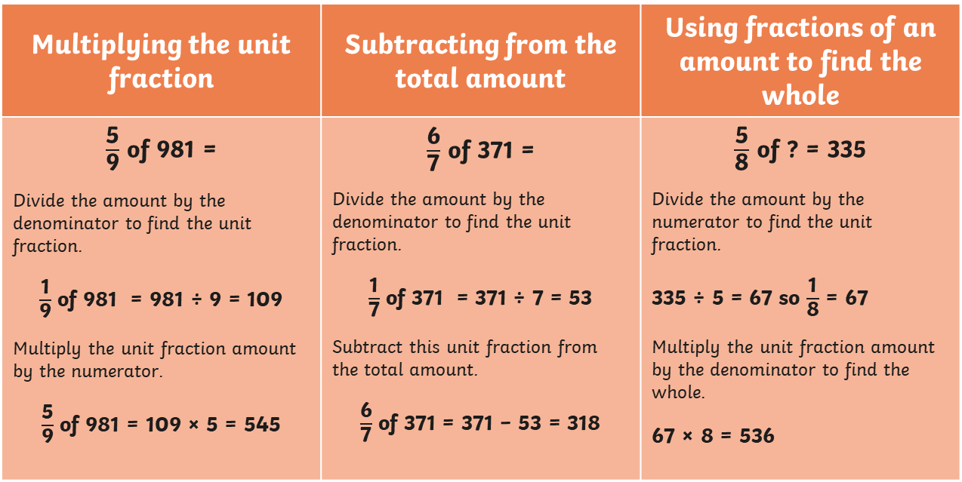
Revise
Calculate fractions of an amount
To calculate fractions of an amount, there are different methods to choose from.
Multiplying the unit fraction | Subtracting from the total amount | Using fractions of an amount to find the whole
$\frac{\text{5}}{\text{9}}$ of 981 = Divide the amount by the denominator to find the unit fraction. $\frac{\text{1}}{\text{9}}$ of 981 = 981 ÷ 9 = 109 Multiply the unit fraction amount by the numerator. $\frac{\text{5}}{\text{9}}$ of 981 = 109 × 5 = 545 | $\frac{\text{6}}{\text{7}}$ of 371 = Divide the amount by the denominator to find the unit fraction. $\frac{\text{1}}{\text{7}}$ of 371 = 371 ÷ 7 = 53 Subtract this unit fraction from the total amount. $\frac{\text{6}}{\text{7}}$ of 371 = 371 − 53 = 318 | $\frac{\text{5}}{\text{8}}$ of ? = 335 Divide the amount by the numerator to find the unit fraction. 335 ÷ 5 = 67 so $\frac{\text{1}}{\text{8}}$ = 67 Multiply the unit fraction amount by the denominator to find the whole. 67 × 8 = 536

Slide 36
Quiz
Calculate fractions of an amount
What is the answer to this fraction calculation?
4
9
486
of
216
54
270
Correct!
Try again!

Slide 37
Quiz
Calculate fractions of an amount
What is the answer to this fraction calculation?
7
8
of
616
77
539
462
Correct!
Try again!

Slide 38
Quiz
Calculate fractions of an amount
What is the missing number in this fraction calculation?
5
7
÷
?
= 405
486
289
567
Correct!
Try again!
Choose another objective

Slide 39
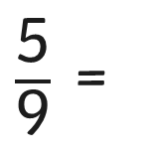
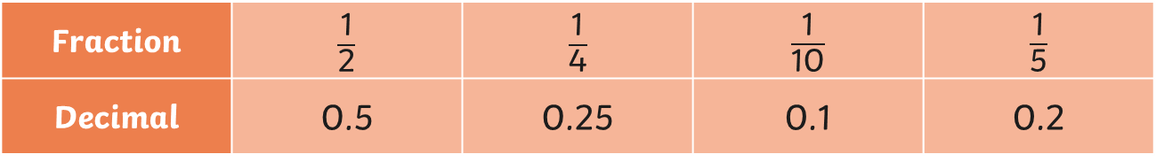


Revise
Calculate decimal equivalents of fractions
Every proper fraction has a decimal number equivalent which we can calculate by dividing the numerator by the denominator.
Common decimal equivalents of fractions can be learnt as facts:
Fraction | $\frac{\text{1}}{\text{2}}$ | $\frac{\text{1}}{\text{4}}$ | $\frac{\text{1}}{\text{10}}$ | $\frac{\text{1}}{\text{5}}$
Decimal | 0.5 | 0.25 | 0.1 | 0.2
We can calculate the decimal equivalents of trickier fractions using written methods of division:
Sometimes a decimal equivalent will keep going infinitely. This is called a recurring decimal. In these cases, you can round the decimal or use a dot to show the same digit is repeated.
$\frac{\text{5}}{\text{9}}$ =
 | 0 | 5 | 5 | 5
9 | 5 | ⁵0 | ⁵0 | ⁵0
$\frac{\text{5}}{\text{9}}$ = 0.56 rounded to two decimal places
$\frac{\text{5}}{\text{9}}$ = 0.$\dot{\text{5}}$

Slide 40
Quiz
Calculate decimal equivalents of fractions
What is the decimal equivalent of this fraction?
3
8
0.125
0.25
0.375
Correct!
Try again!

Slide 41
Quiz
Calculate decimal equivalents of fractions
What is the decimal equivalent of this fraction rounded to two decimal places?
2
7
0.27
0.29
0.28
Correct!
Try again!

Slide 42
Quiz
Calculate decimal equivalents of fractions
What is the decimal equivalent of this fraction rounded to two decimal places?
7
9
0.78
0.76
0.77
Correct!
Try again!
Choose another objective

Slide 43
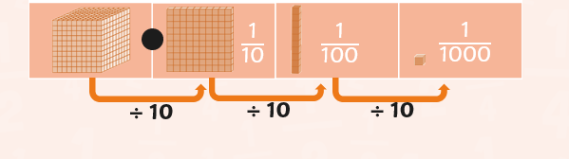
Revise
Identify the value of each digit in numbers to three decimal places
In order to be able to read, write and calculate with decimal numbers, we need to understand the place value of each digit after the decimal point.
As the place value position moves right of the decimal point, the digits become ten times smaller.
ones | tenths | hundredths | thousandths

Slide 44
Quiz
Identify the value of each digit in numbers to three decimal places
What is the value of the underlined digit?
13.508
5
100
5
10
5
1000
Correct!
Try again!

Slide 45
Quiz
Identify the value of each digit in numbers to three decimal places
What is the value of the underlined digit?
529.078
8
1000
8
10
8
100
Correct!
Try again!

Slide 46
Quiz
Identify the value of each digit in numbers to three decimal places
Which digit is in the hundredths place?
40.273
2
3
7
Correct!
Try again!

Slide 47
Quiz
Identify the value of each digit in numbers to three decimal places
What is the place value position of the zero?
197.032
hundredths
tenths
thousandths
Correct!
Try again!
Choose another objective

Slide 48
Revise
Order and compare numbers
with up to three decimal places
To order decimal numbers, we compare the place value of the digits in each number, starting with the digits in the largest place value position.
If numbers have the same digit in a place value position, we look at the digits in the place value position to the right until we find a difference.
When comparing numbers, we can use symbols to show which is the smaller or larger number.
0.873 > 0.853
0.205 < 0.215
<
is less
than
>
is greater
than

Slide 49
Quiz
Order and compare numbers
with up to three decimal places
Choose the correct symbol to compare these decimal numbers.
0.436
0.416
<
>
Correct!
Try again!

Slide 50
Quiz
Order and compare numbers
with up to three decimal places
Choose the correct symbol to compare these decimal numbers.
0.013
0.103
<
>
Correct!
Try again!

Slide 51
Quiz
Order and compare numbers
with up to three decimal places
Choose the correct symbol to compare these decimal numbers.
1024.663
1024.673
<
>
Correct!
Try again!

Slide 52
Quiz
Order and compare numbers
with up to three decimal places
Which of these decimal numbers is the smallest?
0.574
0.572
0.507
Correct!
Try again!

Slide 53
Quiz
Order and compare numbers
with up to three decimal places
Which of these decimal numbers is the largest?
12.638
14.618
14.068
Correct!
Try again!
Choose another objective

Slide 54
Revise
Multiply one-digit numbers with up to two decimal places by whole numbers
Short Multiplication
We use short multiplication when we are multiplying a decimal number by a one-digit number.
Position the decimal number above the one-digit number. Make sure that the place value columns are correct.
Starting at the right-hand side, multiply each digit in the decimal number by the one-digit number.
We can only write a single digit in each column, so if the product is a two-digit number, we have to regroup the number and place into the next column. We do this by writing the number above the digits in the next place holder.
 | ⁴ | ³ | ⁵
 |  | 5 | 3 | 6
× |  | 9
 | 4 | 8 | 2 | 4
When we regroup, we must remember to add this number to the multiplication answer of the next digit. Make sure you give your answer as a decimal.

Slide 55
Revise
Multiply one-digit numbers with up to two decimal places by whole numbers
Long Multiplication
We can use long multiplication when we are multiplying a decimal number by a two-digit number or larger.
Position the decimal number above the two-digit number. Make sure that the place value columns are correct.
 | ₂ | ₄ | ₂ ₁ | ₄
 |  |  | 7 | 2 | 8
× |  | 3 | 6
 |  | 4 | 3 | 6 | 8
 | 2 | 1 | 8 | 4 | 0
 | 2 | 6 | 2 | 0 | 8
 |  | 1 | 1
Starting at the right-hand side, multiply each digit in the decimal number by the ones digit, regrouping and placing into the next column if necessary. Strike the regrouped numbers once you have your first answer so that you don’t confuse any new regroupings.
Place a zero in the furthest right-hand column on the next row down to show we are now going to multiply by a power of ten.
Starting at the right-hand side multiply each digit in the decimal number by the tens digit, regrouping and placing into the next column if necessary.
Finally, add the digits in each column using column addition to find the answer.

Slide 56
Quiz
Multiply one-digit numbers with up to two decimal places by whole numbers
What is the answer to this decimal multiplication?
5.47 × 2
10.814
10.94
10.82
Correct!
Try again!

Slide 57
Quiz
Multiply one-digit numbers with up to two decimal places by whole numbers
What is the answer to this decimal multiplication?
7.08 × 15
106.2
135.04
105.102
Correct!
Try again!

Slide 58
Quiz
Multiply one-digit numbers with up to two decimal places by whole numbers
Which sign makes the statement true?
0.6 × 7
4
<
=
>
Correct!
Try again!

Slide 59
Quiz
Multiply one-digit numbers with up to two decimal places by whole numbers
Which sign makes the statement true?
0.3 × 4
0.25 × 5
<
=
>
Correct!
Try again!

Slide 60
Quiz
Multiply one-digit numbers with up to two decimal places by whole numbers
Which sign makes the statement true?
3.92 × 5
3.53 × 6
<
=
>
Correct!
Try again!
Choose another objective

Slide 61
Revise
Use written division methods in cases where the answer has up to two decimal places
Short Division
We can use short division when we are dividing a decimal number by a one-digit number.
 | 1 | 3 | 2 | 5
4 | 5 | ¹3 | ¹0 | ²0
Start by dividing the first digit of the dividend (the number that is being divided: 53) by the divisor (the number which is being divided into: 4).
Write the answer above the horizontal line and regroup any remainder to the next digit.
Remember to keep the decimal place in the same place value position.

Slide 62
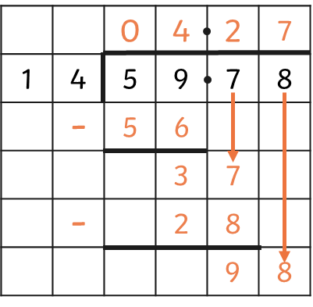
Revise
Use written division methods in cases where the answer has up to two decimal places
Long Division
We can use long division when we are dividing a decimal number by a two-digit number or larger.
Start by dividing the first two digits of the dividend by the divisor. Write the answer above the dividend and the multiple of the divisor below.
Use column subtraction to calculate the remainder and draw down the next digit of the dividend.
Repeat this process until the end of the calculation.
Remember to keep the decimal place in the same place value position.
Sometimes the answer to a decimal division may continue into many decimal places.

Slide 63
Quiz
Use written division methods in cases where the answer has up to two decimal places
What is the answer to this division calculation?
218.56 ÷ 8
27.32
28.42
26.52
Correct!
Try again!

Slide 64
Quiz
Use written division methods in cases where the answer has up to two decimal places
What is the answer to this division?
57 ÷ 6
9.9
9.1
9.5
Correct!
Try again!
Choose another objective

Slide 65
Revise
Round decimal numbers to specified degrees of accuracy
Rounding makes it easier to talk about and use decimal numbers.
We usually round decimal numbers to the nearest whole number or to one or two decimal places depending on the context.
54.6cm rounded to the nearest whole number is 55cm
2.43m rounded to one decimal place is 2.4m
5.328km rounded to one decimal place is 5.3km
£2.47 rounded to one decimal place is £2.50
4.135kg rounded to two decimal places is 4.14kg
To identify whether the decimal will round up or down, look at the digit immediately to the right of the place value position you are rounding to.
1
2
3
4
5
6
7
8
9
If the digit immediately to the right of the place value position you are rounding to is
1, 2, 3 or 4, we round the number down.
If the digit immediately to the right of the place value position you are rounding to is
5, 6, 7, 8 or 9, we round the number up.

Slide 66
Quiz
Round decimal numbers to specified degrees of accuracy
What is 23.625kg rounded to the nearest hundredth?
23.6kg
24kg
23.63kg
Correct!
Try again!

Slide 67
Quiz
Round decimal numbers to specified degrees of accuracy
What is 34.8m rounded to the nearest whole metre?
35m
40m
30m
Correct!
Try again!

Slide 68
Quiz
Round decimal numbers to specified degrees of accuracy
Which digit makes this statement true?
853.187? rounded to the nearest thousandth is 853.188
3
4
5
Correct!
Try again!

Slide 69
Quiz
Round decimal numbers to specified degrees of accuracy
Which digit makes this statement true?
12.04?2 rounded to the nearest hundredth is 12.04
8
0
9
Correct!
Try again!
Choose another objective

Slide 70
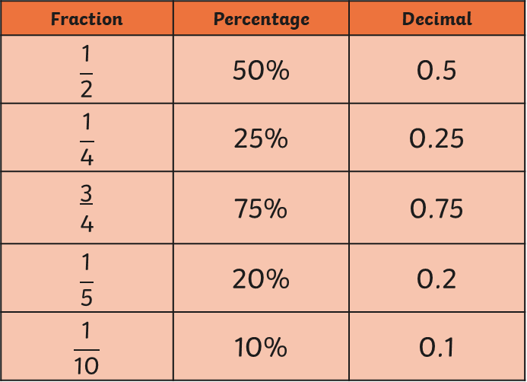
Revise
Recall and use equivalences between simple fractions, decimals and percentages
Fractions, decimals and percentages are all different ways of expressing a proportion.
A percentage is a proportion out of one hundred.
The sign % stands for 'per cent' which means 'out of 100’.
Here are some fraction, percentage and decimal equivalents that we can learn as facts:
Fraction | Percentage | Decimal
$$\frac{\text{1}}{\text{2}}$$ | 50% | 0.5
$$\frac{\text{1}}{\text{4}}$$ | 25% | 0.25
3 4 | 75% | 0.75
$$\frac{\text{1}}{\text{5}}$$ | 20% | 0.2
$$\frac{\text{1}}{\text{10}}$$ | 10% | 0.1

Slide 71
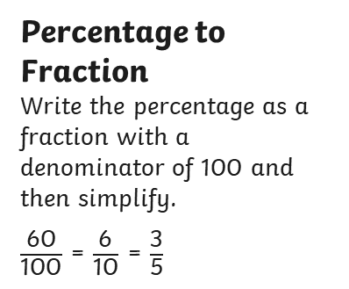
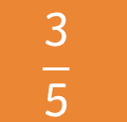
Revise
Recall and use equivalences between simple fractions, decimals and percentages
For trickier equivalents, we can use the rules in this diagram to help us:
Fraction
Percentage to Fraction
Write the percentage as a fraction with a denominator of 100 and then simplify.
$\frac{\text{60}}{\text{100}}$ = $\frac{\text{6}}{\text{10}}$ = $\frac{\text{3}}{\text{5}}$
$$\frac{\text{3}}{\text{5}}$$
Fraction to Decimal
Divide the numerator by the denominator.
3 = 3 ÷ 5 = 0.6
5
Percentage
60%
Decimal
0.6
Decimal to Percentage
Multiply the decimal by 100 and add the % sign.
0.6 x 100 = 60%

Slide 72
Quiz
Recall and use equivalences between simple fractions, decimals and percentages
Convert this decimal into a percentage.
0.467
467%
46%
46.7%
Correct!
Try again!

Slide 73
Quiz
Recall and use equivalences between simple fractions, decimals and percentages
Convert this decimal into a fraction.
0.35
7
5
7
20
7
100
Correct!
Try again!

Slide 74
Quiz
Recall and use equivalences between simple fractions, decimals and percentages
Convert this fraction into a percentage.
5
8
62.5%
60%
58%
Correct!
Try again!

Slide 75
Quiz
Recall and use equivalences between simple fractions, decimals and percentages
Convert this percentage into a decimal rounded to the nearest hundredth.
45.8%
0.45
0.46
0.48
Correct!
Try again!
Choose another objective

