Slide 1

Year 2 welcome meeting

Slide 2
Class teacher: Mrs Oluremi
Teaching assistants: Miss Ashton,
Mrs Nowell (after half term)

Slide 3

We are a Community of love, learning and growing in the image of Christ

Slide 4
Autumn term
Travel and transport
Nurturing nurses
Spring term
Summer term
Explorers
Sensational Safari
Food glorious food
Castles, kings and queens
Theme

Slide 5
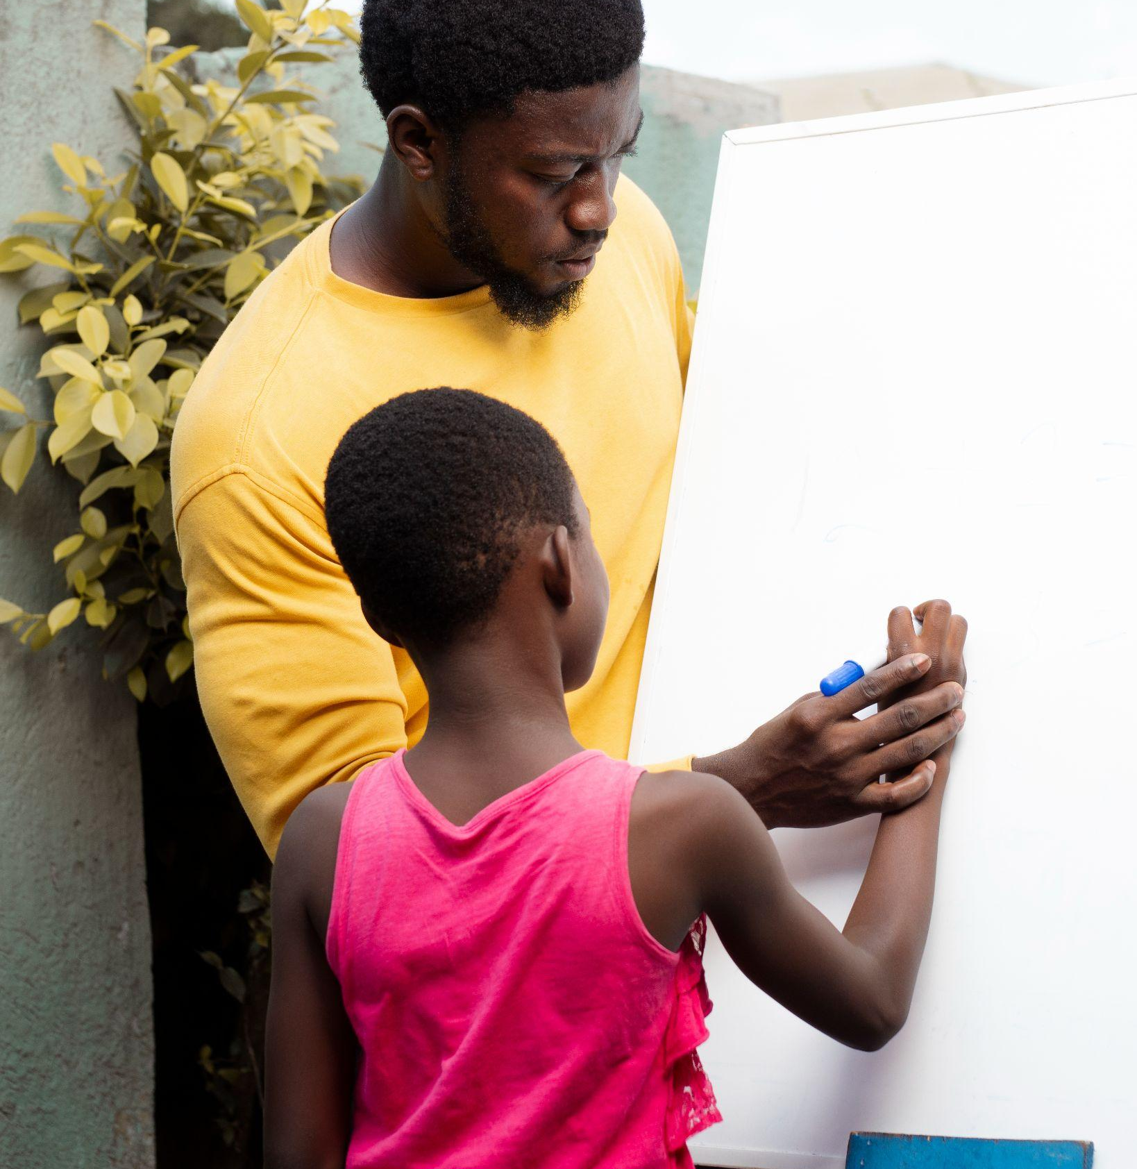
Handwriting
Letterjoin
Whole school uniform approach

Slide 6
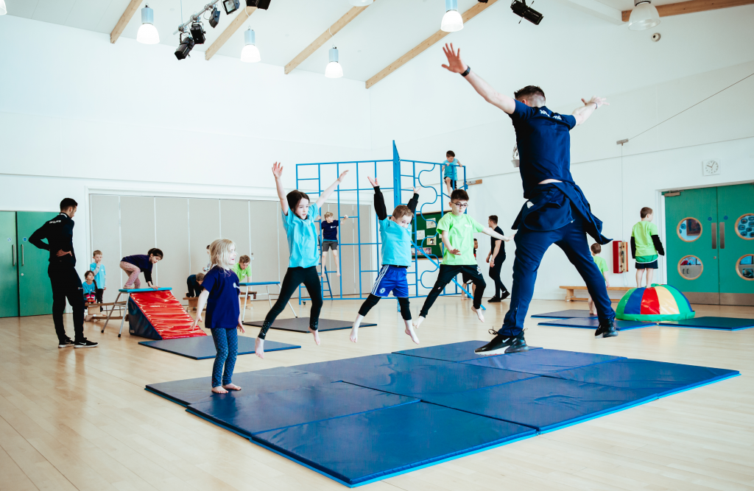
P.E.
This term P.E. lessons are on Tuesdays until October half term (dance with Ricky) and Wednesday until Christmas (games with Mr Dingley). Children will need to come to school dressed in their P.E. kit
P.E Kit:
Black shorts
School t-shirt
Trainers or pumps (please ensure these are a good fit and your child is capable of doing their own laces)
Tracksuit bottoms and a school hoody for the colder weather
NO EARRINGS!

Slide 7
Homework
Homework books are sent out on a Friday and need to be back in by next Wednesday so they can be marked and new homework added.
Homework is Maths which reinforces something we have covered in class.
You may also find some additional handwriting or grammar activities that we covered during lessons.
Always check the newsletter for a talk topic.

Slide 8
Homework
Please continue to help your child with their reading.
When your child has read to you please sign their reading diary so we know an adult has heard them read and include any relevant comments particularly if there are any difficulties. Remember to ask questions to check that they are understanding what they are reading about.
Reading books need to be in school everyday.
Children will continue to be heard read in school.

Slide 9
Homework
As part of their homework some children are given weekly spellings. The spellings are taken from the RWI book they are currently reading and should already be familiar to the children and contain letters and sounds they have been practising reading and writing.
In addition there are a few “red” words which don’t follow the expected pattern but are necessary for the children to know.
These will be tested in RWI lessons on a Wednesday.

Slide 10
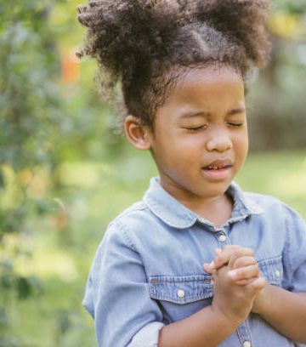
Catholic life
Family masses are usually the first Sunday of every month.
KS1 Mass- Once a term in the school hall.
Penitential Service in Advent and Lent.
Class prayer services during Advent and Lent.
Inspire workshop will be held at some point in the year.
Please do attend these events where possible.

Slide 11
Trips
As part of our history unit on Travel and Transport, we will be visiting the Transport Museum; the letters have been sent home last week.
The Snowdome has been booked for December 16th- letters will be sent home.
In the summer term, we are planning to visit Warwick Castle.

Slide 12
General reminders

Slide 13
Uniform: plain gold stud earrings only! No nail varnish and long hair to be tied up.
School day begins from 8:40.
No holidays to be booked in term time- they will not be authorised.
Please ensure all uniform is named.
Please follow us on Twitter to get the latest updates @StOsburgs.
Water bottle in school everyday.
Please inform the office if someone else will be picking up your child- if this is going to be a regular arrangement please let them know.

Slide 14
Contact
Chat at the end of the day;
More serious matters- contact the office to make an appointment;
Parents evenings

Slide 15

Thank you

