Slide 1
Year 6
Meanwhile, some of us were checking out what Year 6 is like.
Notes:
Judith, Trumaine, Poppy.

Slide 2
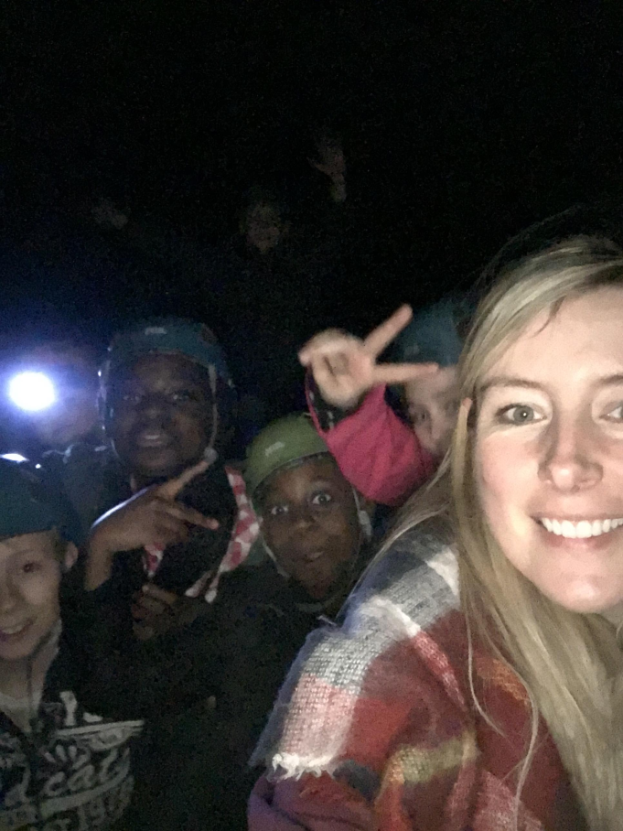
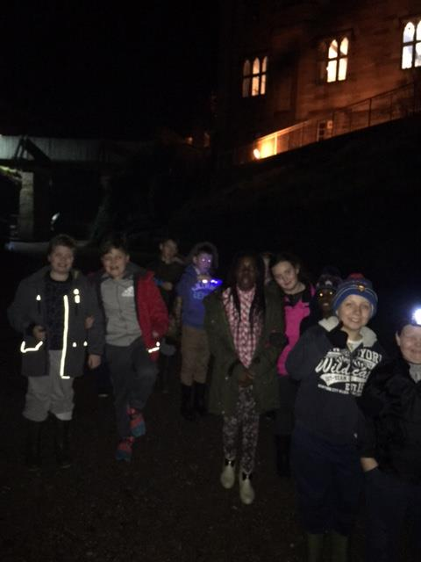
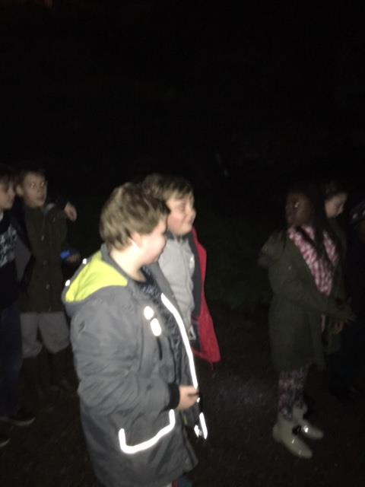
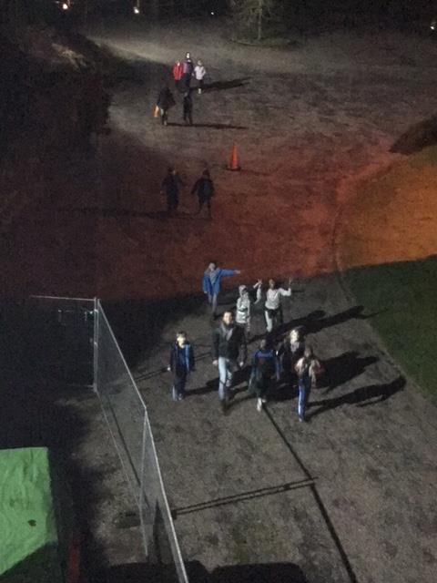
Notes:
Nighline pictures
Bella, Derrcik

Slide 3
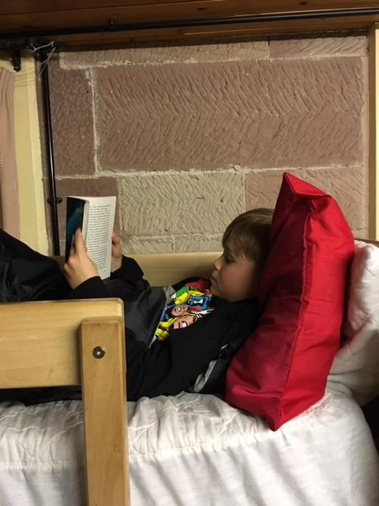
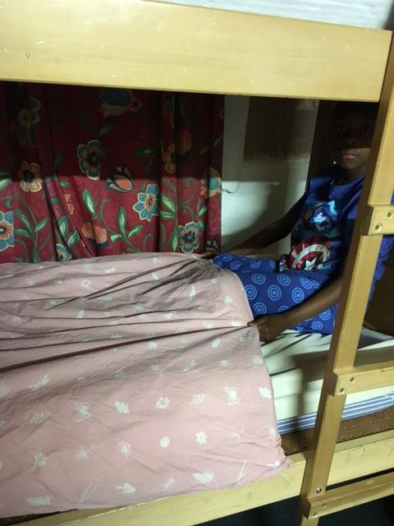
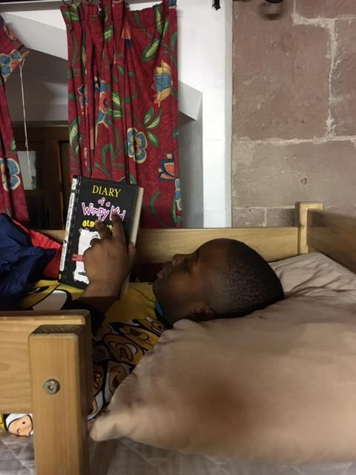
Time for bed…
Notes:
Night time- funny comment. Faith, Molly, Brandon, Precious.

Slide 4
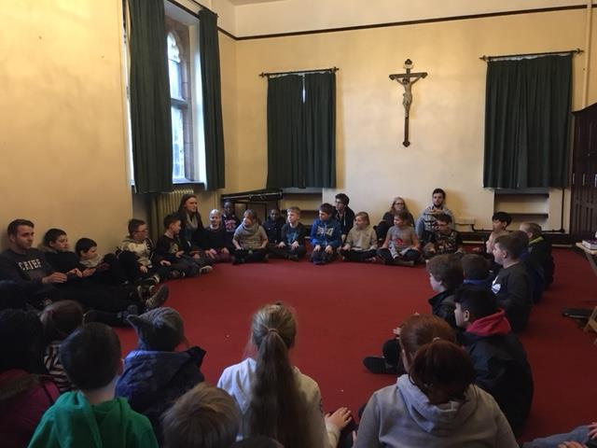
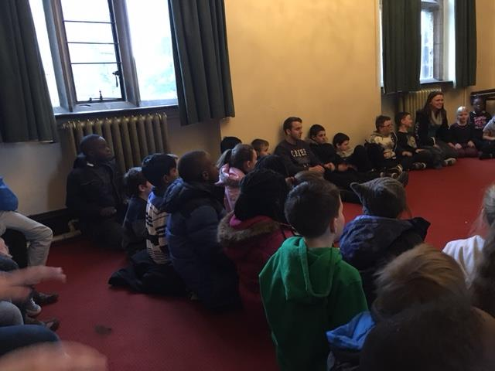
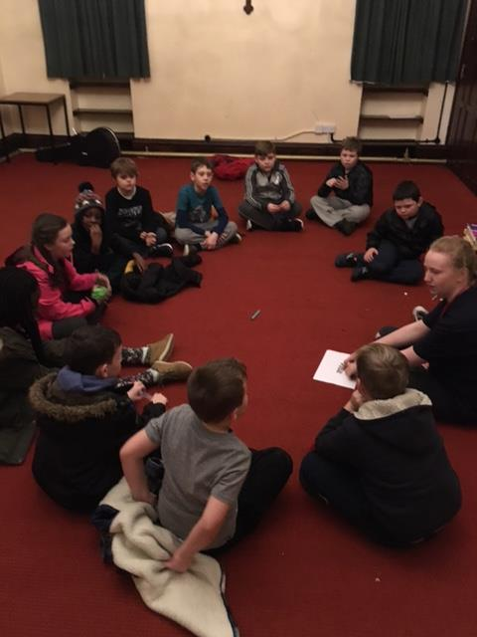
Prayer and meditation
Notes:
Prayer, meditation times- chn speak, discipleship

Slide 5
Bidding prayers
Discipleship & the Year of Mercy
Notes:
Judith, Trumaine, Poppy, Gabi, Kanye.

