Slide 1
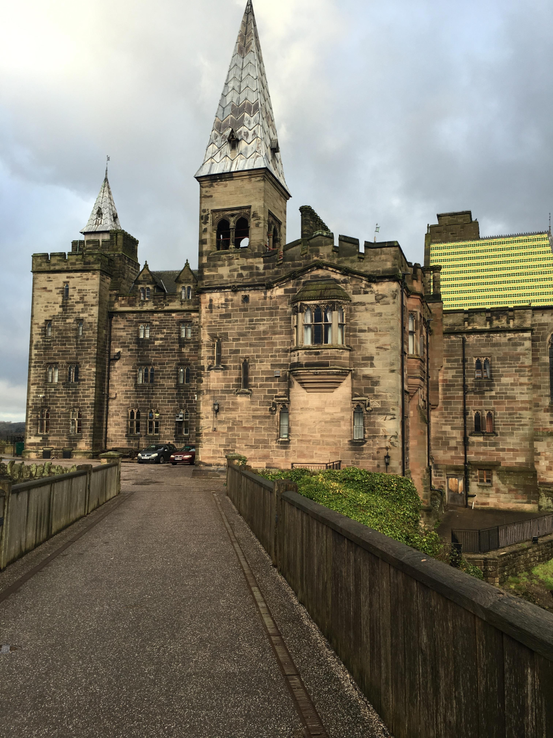
Welcome to our
Alton Castle assembly.

Slide 2

We gather
Morning prayer.
Dear Jesus,
I offer to you today
All that I do and think and say
All my work and happy play
I offer to you, my God today.
Amen
Notes:
Dorcas, Wanessa lead

Slide 3
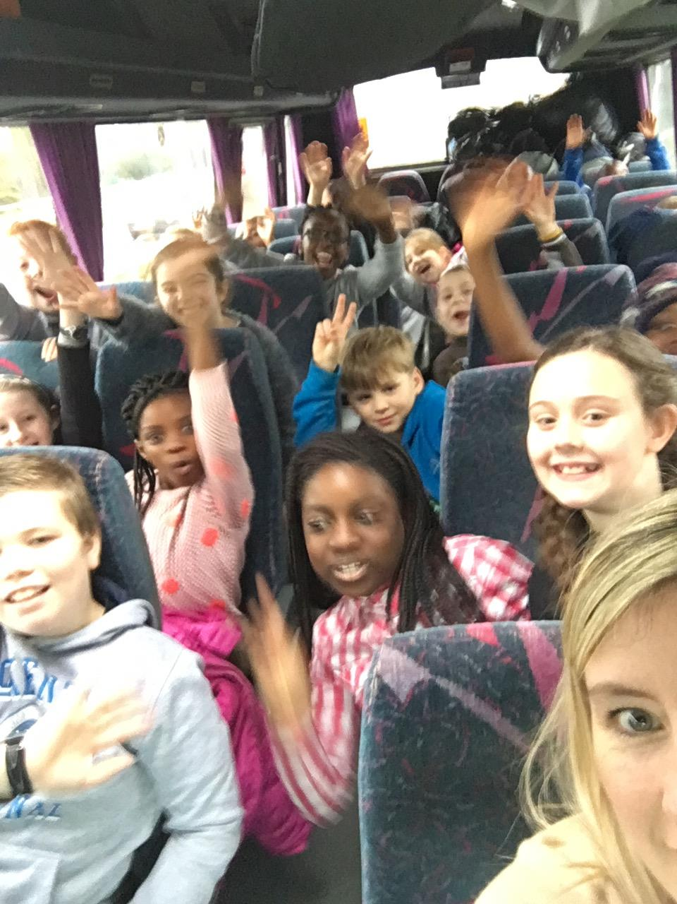
Alton castle
We were on our way!
Notes:
Child welcomes parents – Connor journey

Slide 4
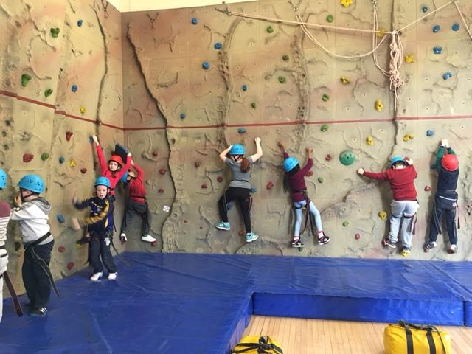
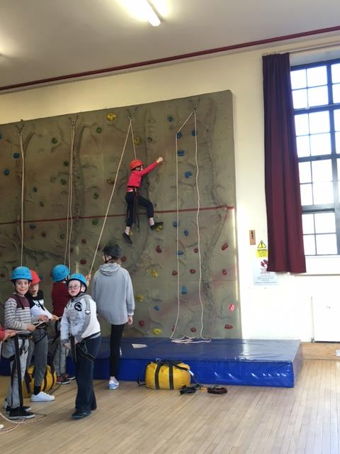
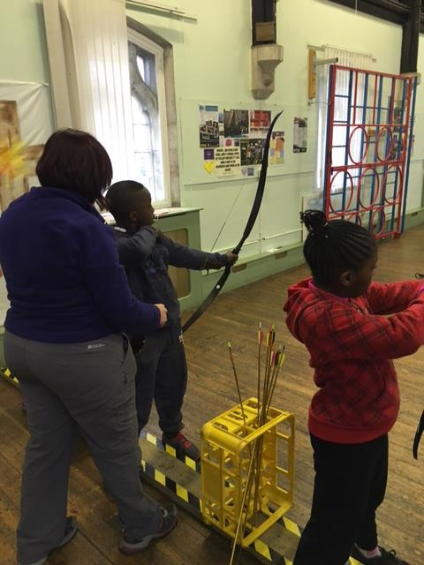
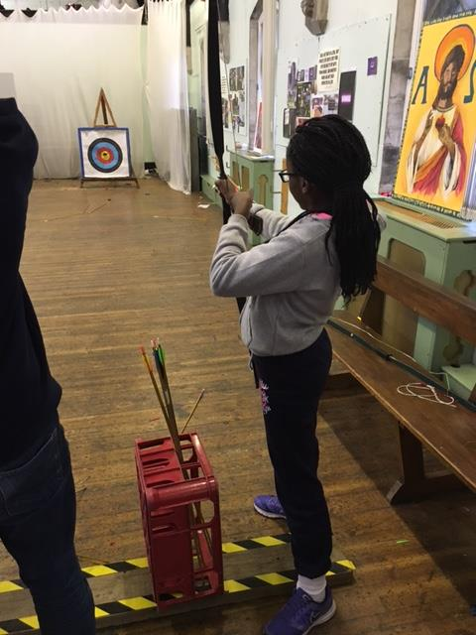
Notes:
Children speak about 2 activities slides with music, then what I learnt about myself
Afonso, Rosie, Brendan, Patryk, Wanessa

Slide 5


