Slide 1



LIFE/work balance
We have started a #LIFEworkbalance campaign and we need your help to complete our LIFE/work balance survey.
We hope to publish the results soon, so please give 15 minutes of your time to help us get a true picture of school life.
Want to be a part of this campaign? Take the survey on our website and share it with your colleagues!
© Classroom Secrets Limited 2019

Slide 2
Year 1 – Autumn Block 3 – Shape – Patterns with 2D and 3D Shapes
About This Resource:
This PowerPoint has been designed to support your teaching of this small step. It includes a starter activity and an example of each question from the Varied Fluency and Reasoning and Problem Solving resources also provided in this pack. You can choose to work through all examples provided or a selection of them depending on the needs of your class.
National Curriculum Objectives:
Mathematics Year 1: (1G1a) Recognise and name common 2-D shapes [for example, rectangles (including squares), circles and triangles]
Mathematics Year 1: (1G1b) Recognise and name common 3-D shapes [for example, cuboids (including cubes), pyramids and spheres]
More Year 1 Shape resources
Did you like this resource? Don’t forget to review it on our website.
© Classroom Secrets Limited 2018

Slide 3
Year 1 – Autumn Block 3 – Shape
Step 5: Patterns with 2D and 3D Shapes
© Classroom Secrets Limited 2018

Slide 4
Introduction
Continue the repeating pattern below.
What colour will come next?
?
© Classroom Secrets Limited 2018

Slide 5
Introduction
Continue the repeating pattern below.
What colour will come next?
© Classroom Secrets Limited 2018

Slide 6
Varied Fluency 1
Colour the shapes to create a pattern.
© Classroom Secrets Limited 2018

Slide 7
Varied Fluency 1
Colour the shapes to create a pattern.
Various answers: shapes to be coloured in an ABC pattern.
© Classroom Secrets Limited 2018

Slide 8
Varied Fluency 2
Draw the missing shape in these patterns.
A.
?
B.
?
© Classroom Secrets Limited 2018

Slide 9
Varied Fluency 2
Draw the missing shape in these patterns.
A.
B.
© Classroom Secrets Limited 2018

Slide 10
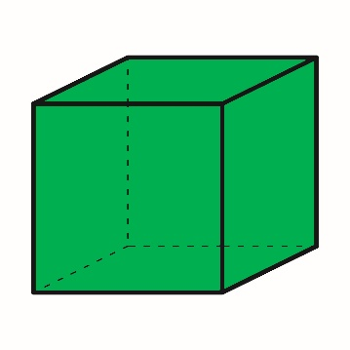
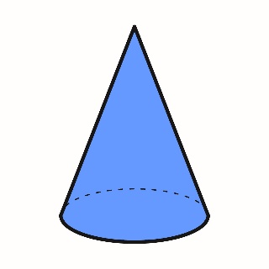
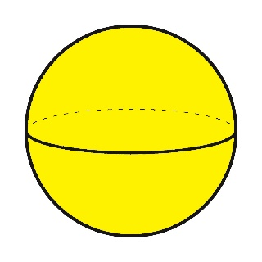
Varied Fluency 3
Tick the shape that continues the pattern.
A. |  |  |  | B. |  |  |  | C.
© Classroom Secrets Limited 2018

Slide 11
Varied Fluency 3
Tick the shape that continues the pattern.
A. |  |  |  | B. |  |  |  | C. |  | 
© Classroom Secrets Limited 2018

Slide 12
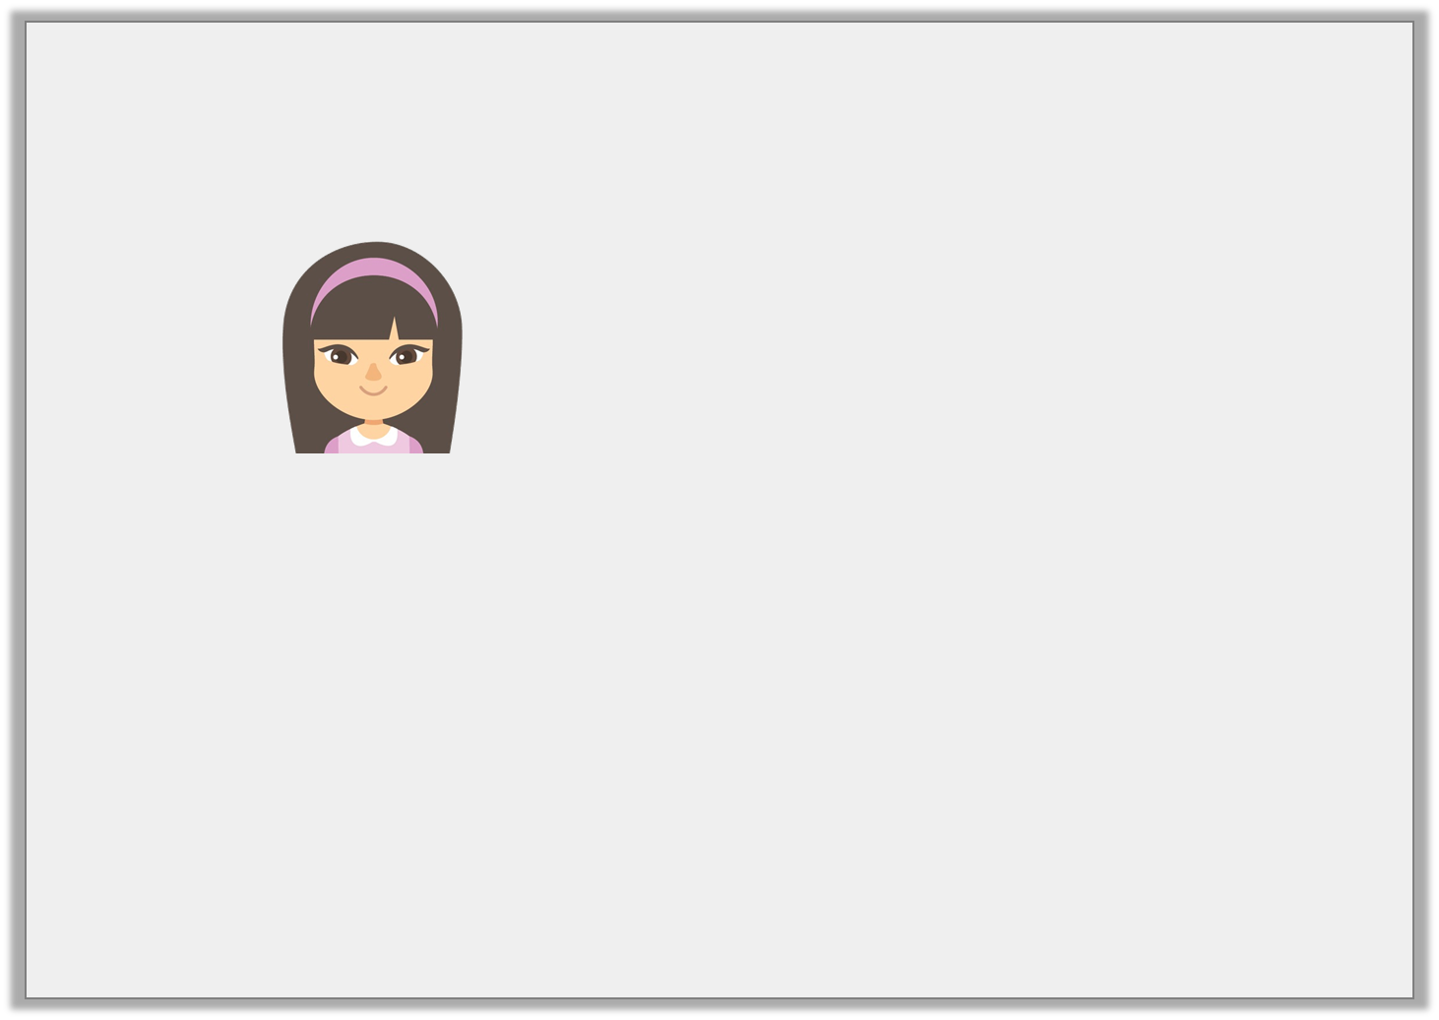
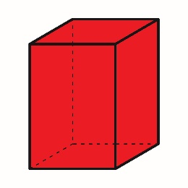
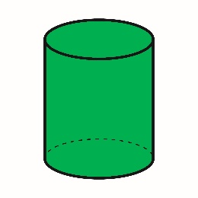
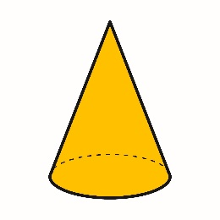
Varied Fluency 4
True or false?
The next shape in my pattern will be a cylinder.
© Classroom Secrets Limited 2018

Slide 13
Varied Fluency 4
True or false?
True
The next shape in my pattern will be a cylinder.
© Classroom Secrets Limited 2018

Slide 14
Problem Solving 1
Make a pattern using only these shapes.
© Classroom Secrets Limited 2018

Slide 15
Problem Solving 1
Make a pattern using only these shapes.
Various answers, for example:
© Classroom Secrets Limited 2018

Slide 16
Problem Solving 2
Use these clues to create a pattern and then repeat it.
1. | The 2nd in the pattern is a triangle.
2. | The 1st shape in the pattern is a red circle.
3. | The last shape in the pattern is an orange square.
4. | The triangle is green.
© Classroom Secrets Limited 2018

Slide 17
Problem Solving 2
Use these clues to create a pattern and then repeat it.
1. | The 2nd in the pattern is a triangle.
2. | The 1st shape in the pattern is a red circle.
3. | The last shape in the pattern is an orange square.
4. | The triangle is green.
© Classroom Secrets Limited 2018

Slide 18
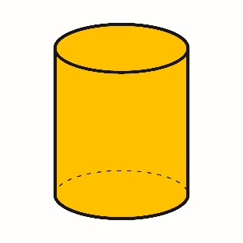
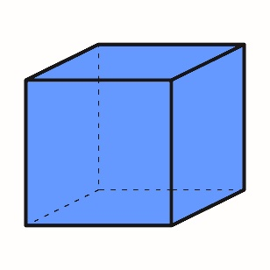
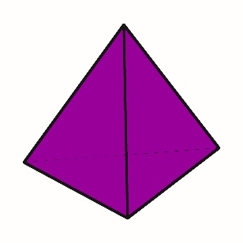
Reasoning 1
Jacob is drawing around the 3D shapes below to create a pattern.
Here is the pattern he has created.
What has Jacob done wrong? Explain your answer.
© Classroom Secrets Limited 2018

Slide 19
Reasoning 1
Jacob is drawing around the 3D shapes below to create a pattern.
Here is the pattern he has created.
What has Jacob done wrong? Explain your answer.
The order Jacob has used is incorrect because…
© Classroom Secrets Limited 2018

Slide 20
Reasoning 1
Jacob is drawing around the 3D shapes below to create a pattern.
Here is the pattern he has created.
What has Jacob done wrong? Explain your answer.
The order Jacob has used is incorrect because he should have drawn around the cube after the triangular based pyramid and before the cylinder.
© Classroom Secrets Limited 2018

